Slide 1
Centre For Accessibility Australia
Digital Advocacy Grant WA
Evaluation Report
Prepared by The Behaviour Change Collaborative
  AprIL 2025

Slide 2
Background

Slide 3
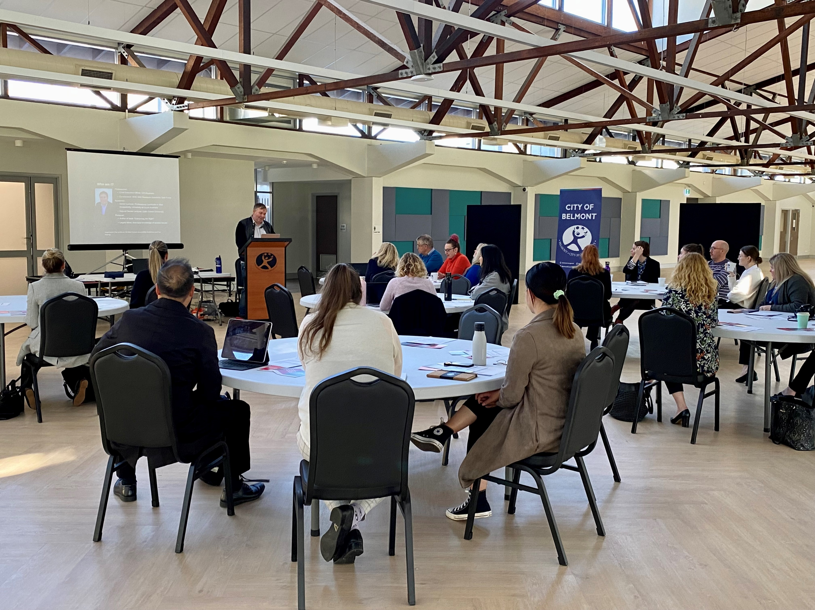
Project background and objectives
Background
In 2022, Centre for Accessibility (CFA Australia) was provided grant funding by the Department of Communities WA (DoC) for a new state-wide initiative called the Digital Access WA Project. The project was established to create advocacy, community education and to improve the State’s standards of digital access.
The Behaviour Change Collaborative was approached by CFA Australia to lead evaluation of the project. A logic model and theory of change was created at a kick-off workshop facilitated by The BCC, and attended by staff from CFA Australia, Media on Mars and Department of Communities WA. Outputs from this workshop were used to establish impact and outcome measures and inform project evaluation.
The project aimed to empower organisations across WA to create more inclusive digital environments, and to ensure everyone has equal access to information, regardless of ability.
Key aspects of the project were the Discovery Project, which sought to amplify the voices of people living with disability, Training Initiatives to support organisations better understand and implement digital access, and the Engage Survey which was developed and administered by The BCC to measure the Digital Access WA Project’s impact.

Slide 4
How to read this report
Contents
Samples and question references
The data on each page includes a reference to the exact wording of the relevant question(s) shown to respondents in the survey. This can be found in the page footer.
The unweighted sample size for each group shown on the page is also included in the page footer.
Significance testing
Significance testing has been applied at a 95% confidence interval.
Significant differences are indicated by
A green box: to denote a significantly higher result and
A red box: to indicate a significantly lower result.
Item | Page
Background | 2
Evaluation findings: Part 1 program logic | 6
Evaluation findings: Part 2 audit to implementation roadmaps | 17
Evaluation findings: Part 3 discovery workshops | 31
Evaluation findings: Part 4 introduction to inclusive design course | 46
Findings and recommendations | 57
Appendix 1: Pre audit survey | 66
Appendix 2: Post audit survey | 72
Appendix 3: Pre workshop survey | 80
Appendix 4: Post workshop survey | 85
Appendix 5: Pre course survey | 90
Appendix 6: Post course survey

Slide 5
Evaluation findings

Slide 6
Part 1: Program logic workshop

Slide 7
Purpose and methodology [LOGIC WORKSHOP]
At initiation of the Grant, CFA Australia, The BCC and Media on Mars met to discuss the purpose and program design for the Digital Advocacy Project.
The Program Logic Workshop is designed to develop a holistic understanding of a program's goals. This involves identifying the program’s theory of change, objectives and establishing causal links between:
    Executed actions
    Immediate outcomes of activities
    Short and mid-term shifts
    Policy and societal benefits
This workshop aids program development and evaluation and ensures that activities undertaken are aligned with desired program outcomes. The output of this activity were Program Logic with the Impacts, Outcomes and Activities sections populated.
The BCC used the outcomes of the workshop to produce an evaluation matrix that was intended to help all partner organisations capture and organise key indicators for the project – both process measures (primarily captured and held by CFA Australia and Media on Mars) and impact measures (primarily captured by The BCC and reported herein).
The evaluation matrix is provided in a separate attachment to this report, for reference.

Slide 8
Our Theory of Change
Through doing activity X …
We will address issue / problem Y..
And achieve outcome Z
By engaging with and training organisations in the NFP, govt, service provider and education sectors to make their digital assets accessible.
A lack of understanding, commitment and capability in organisations in the NFP, govt, service provider and education sectors to digital accessibility for people with disability.
Increase the number of organisations in the NFP, govt, service provider and education sectors that have accessible digital assets and are committed to maintaining and improving accessibility for people with disability.
“We will achieve an increase in the number of organisations that have implemented and are committed to maintaining digital accessibility by addressing a lack of understanding, commitment and capability to implement accessibility principles through engaging with and training organisations to make their digital assets accessible”
Notes:
At an over-all campaign goal level – first we will work though what the outcome and issue are – activities later.

Slide 9
Policy/Program Goal or Objectives
Theory of Change
What it costs
What you do
What you deliver
Short & mid term
Long term impacts
Notes:
This version for printing out and group complete

Slide 10

Impact is the extent to which change that can be attributed to the Plan affects the organisation’s goals, generally measured with external data some time afterwards
Digital accessibility principles are consistently applied and maintained (through audits) in the relevant sectors
Policy framework has changed to mandate audits (e.g. mandatory on sector tenders)
Independent organisation(s), preferably govt business unit, to audit digital assets (led by people with disability)
Raised awareness and understanding of need for accessibility in general population
Better education and employment opportunities and outcomes for people with disability
people with disability can easily, effectively and consistently access the information and services they need (relevant sectors)
people with disability experience few/no barriers in conducting digital tasks related to the relevant sectors (and beyond)
Accessibility training is embedded in educational institutions and standard in design, development and digital marketing courses
Good training is available and affordable for those who wish to upskill
Impact

Slide 11

Outcomes cover internal change, immediate response and behaviour change: they are tailored to the Plan
Increased organisational and individual understanding of importance of accessibility and how to go about it in sectors (road map)
Increased organisational and individual commitment to implement and maintain accessibility in sectors
Increased organisational and individual capability (skills, efficacy) to implement and maintain accessibility in sectors
An increase in the number of organisations (and individual) in the sectors that have made and committed to maintaining their digital assets as accessible
people with disability have increased independent access to content in the relevant sectors
Increased efficacy and capability of organisations and individuals to implement accessibility principles in the relevant sectors
people with disability feel included and valued in developing and implementing solutions
Implementation of procurement standard (ASEN301549) in WA Govt
Recognition of accessibility training / implementation
Increased number of champions for accessibility in sectors
Increased linkage/ networking / cross-promotion between champions and champion organisations
Increased accountability through growing knowledge/ evidence base of audited accessibility of sectors (through CFA Australia data hub)
Increased knowledge of and trust in CFA Australia from organisations and individuals
People feel supported in their road to accessibility
Ministerial endorsement of desired policy changes
Government recognises importance and value of increased accessibility of their own assets, through commitment to roll out accessibility more broadly
Increase in CFA Australia memberships
Increase in number of organisations financially committed to maintaining accessibility (and data)
Increase in number of orgs in regular contact with CFA Australia (inquiries, attendance at awards, newsletter subscribers)
Outcomes

Slide 12

Activities describe the process of carrying out/delivering a task
Host an event for potential participants
Call for interest from advocacy organisations for their clients to participate (metric: how many responded, quotes, testimonials)
Encourage communication between advocacy orgs (number of meetings, contacts, identify joint opportunities, make joint funding applications)
Theory of change workshop for advocacy generally
Decide creative and content direction
Design interview guide
Select participants & seek permissions and consent
Interview participants
Create videos (editing, reviewing, captioning, accessibility features)
Create content bank of stories (for sharing and workshop content)
Create timeline and guide for sharing & content
Share content bank (with advocacy partners, DoC and disability sector.
CFA Australia to promote and share online
Create landing page
Activities
PART 1:
Discovery project

Slide 13
Activities describe the process of carrying out/delivering a task
EOI for each sector to identify potential orgs to participate in the audit process (leads to indication of demand)
Start with NFP sector, beginning with advocacy orgs
Select organisations (criteria?) & decide who will make the decision (DoC?)
Develop roadmap structure & design
Liaise with orgs to get a representative sample of their website
Conduct audits
Prepare individual roadmaps from each audit
Design data hub (on CFA Australia website)
Add existing orgs into data hub (with permission)
Mapping process for ministerial endorsement
EOI for each sector to identify potential orgs to participate in the audit process (leads to indication of demand)
Develop new incentives and rewards for engaging in audit process
Activities
PART 2 & 4:
Engage, survey, report, audit roadmaps

Slide 14
Activities describe the process of carrying out/ delivering a task
Develop/ refine design and content of workshops (technical and engagement)
Identify specific locations (towns, venues)
Invite lists (leverage local contacts in regional areas)
Schedules
Marketing and promotion (F2F & online)
Organise travel
Deliver 3 hrs per workshop
Record testimonials, photos
Online – obtain platform, program content
Create training pathways options map
Explore potential for some form of accreditation / micro-credentials
Activities
PART 3:
Discovery Workshops

Slide 15
Activities describe the process of carrying out/ delivering a task
Citizen-informed engagement / consultation on policy changes (potentially out of scope)
Map policy change journey
Identify pathways to change
Meet with minister and govt agencies
Meet with lawyers for identification of legal pathways for change
Sharing progress / goals via current assets
Explore options to scale / share successes
Activities
PART 5:
Policy Development Advocacy

Slide 16
Activities describe the process of carrying out/delivering a task
Activities
Develop framing and purpose of event / content
Select venue
Get an MP
Lived experience (identify people with disability to be involved/present)
Contractors
Ensure accessibility
Marketing and promotion (PR)
Invite list
Make video
PART 6:
Celebrating success

Slide 17
Part 2: Audit-to-implementation roadmaps

Slide 18
Audits and roadmap - background
Background
CFA Australia provided select organisations from within the not-for-profit and education sectors audits of their websites, funded by the Department of Communities WA grant, to evaluate their current level of digital accessibility. Audit-to-implementation roadmaps were developed to outline the digital accessibility issues and to recommend the steps needed to improve and maintain accessibility. The purpose of this phase of the project was to support organisations to make the changes needed to apply a high level of accessibility to their websites and digital services, ensuring they are equipped with the knowledge and understanding of how to realise their access goals and take practical steps to achieve them.
Delivery
A total of 28 audits were undertaken by CFA Australia, with 21 not-for-profits and 7 schools participating.

Slide 19
Audit details
Participating organisation | Status | Participating organisation | Status
Kin Advocacy | Completed | DV Assist | Completed
Ability Heroes | Completed | Leadership WA | Completed
Explorability Inc. | Completed | Para and Ability Dance WA | Completed
Advocacy WA | Completed | Leeming Senior High School | Completed
Kalparrin | Completed | Ashburton Drive Primary School | Completed
Microboards | Completed | O’Connor Primary School | Completed
LampInc | Completed | Coolbellup Community School | Completed
Crosslinks | Completed | Kalamunda Senior High School | Completed
Indigo Solutions | Completed | East Victoria Park Education Support Centre | Completed
Development Disability WA | Completed | Belridge Secondary Education Support Centre | Completed
Imperial Calisthenic College | Completed | Cahoots (Camps & Adventures) | Completed
WITWA | Completed | Tuart Place | Completed
PWDWA | Completed | Senses WA | Completed
Broome Circle | Completed
Valuedlives | Completed

Slide 20
Audit details
Evaluation
Each organisation participating in the audit process nominated a representative to take part in a ‘pre audit’ survey to establish baseline measures. A ‘post audit’ survey was subsequently completed approximately three months after each organisation had received their audit roadmap. This timeframe was selected to allow organisations time to implement at least some of the actions recommended in their Roadmap and to observe their impacts on their digital accessibility.
Survey design
Two evaluation surveys were designed for the audits and roadmaps – one pre-audit survey and one post-audit survey. The surveys were developed by The BCC in consultation with CFA Australia and were approximately 10 minutes duration each. The surveys were administered by CFA Australia prior to and following completion of the audit process.
Topics
The survey included both closed and open-ended question types, covering the broad topics of:
Knowledge of digital accessibility
Attitudes towards digital accessibility
Intentions to improve organisation’s digital accessibility
Perceived challenges to improving digital accessibility
Demographics
The post-audit survey included both questions from the pre-audit survey to identify changes in attitudes, intentions and knowledge, as well as additional evaluation questions specific to the audit and roadmap processes.
Sample
A total of 33 post-audit and 20 pre-audit survey responses were recorded.

Slide 21
Those who participated in CFA’s website audit process almost universally felt it to be highly useful for their organisation, with 95% reporting that the process was informative and 90% agreeing that it provided clear guidance about how to increase their organisation’s digital accessibility
Usefulness of the audit process
Reported that the audit process was informative
Agreed that the audit process provided clear guidance about how to increase their organisation’s digital accessibility
Q. How informative was the Centre for Accessibility Digital Audit process for your organisation? Base n=20
Q. How much do you agree or disagree that the audit process provided clear guidance about how to increase the digital accessibility of your organisation? Base n=20

Slide 22
The usefulness of the audit process is evidenced by the impacts it had, with participants recording a substantial uplift in their knowledge about digital accessibility post-audit. Participants were more likely to say they had ‘moderate’ or ‘high’ levels of knowledge about website accessibility for people with disability, the Web Content Accessibility Guidelines and Standards, and the technical processes of making their organisation’s website accessible for people with disability compared to before the audit process.
Notably, close to two-thirds of those who completed the audit process felt they subsequently had moderate or high technical knowledge about how to make their organisations’ website accessible.
Knowledge about digital accessibility (Nett: Moderate/high)
How much knowledge is there in your school/organisation about…
The technical processes of making your organisation’s website accessible for people with disability?
The Web Content Accessibility Guidelines and Standards
Website accessibility for people with disability?
Pre-audit
Post-audit
Q. How much knowledge is there in your organisation about website accessibility for people with disability? Pre-audit base n = 31; Post-audit base n = 20
Q. How much knowledge is there in your school/organisation about the Website Content Accessibility Guidelines and Standards? Pre-audit base n = 31; Post-audit base n = 18
Q. How much knowledge is there in your school/organisation about the technical process of making your organisation’s website accessible for people with disability? Pre-audit base n = 20; Post-audit base n = 18

Slide 23
Participants in the audit process also showed a substantial improvement in their ‘confidence’ in their organisation’s skills and their resources to improve the accessibility of its website.
Confidence to improve organisation’s website accessibility
(Nett: Confident)
How confident are you that your school/organisation has….
The resources to improve the accessibility of its website
The skills to improve the accessibility of its website
Pre-audit
Post-audit
Q. How confident are you that your school/organisation has the skills to improve the accessibility of its website? Pre-audit base n=31; Post-audit survey base n=20
Q. How confident are you that your school/organisation has the resources to improve the accessibility of its website? Pre-audit base n=31; Post-audit survey base n=20

Slide 24
The evaluation indicated that audit process had a positive impact on the accessibility of participating organisations’ websites, with estimations of the accessible proportions of these website rising significantly after completing the audit process.
Half of participants indicated that at least three-quarters of their website was accessible following implementation of the audit actions, compared to only 20% prior to the audits.
Proportion of organisation’s website that is digitally accessible
Pre-audit
Post-audit
51-75%
76-100%
Unsure
Q. How much of your organisation's website do you think is currently accessible to people with disability (i.e. meets the Web Content Accessibility Guidelines)? Pre-audit base n=31; Post-audit survey base n=20
Notes:
Flip to columnn

Slide 25
Following the audit process, participants recorded an increase in their likelihood to regularly commission an external audit of their website and to become a non-financial member of CFA Australia, though their likelihood to become a financial member of CFA Australia remained relatively low.
Organisations’ likelihood to internally monitor their websites accessibility and to ensure staff are trained to implement accessibility principles remained high and stable pre compared to post-audit. This likely reflects a high degree of commitment to digital accessibility that prompted these organisations to take part in the audit process in the first place.
Likelihood to take action to improve organisation’s digital accessibility
(Nett: Likely)
Commission an external audit of your organisation’s website regularly
Become a non-financial member of the Centre for Accessibility
Become a financial member of the Centre for Accessibility
Internally monitor the accessibility of your organisation’s website
Ensure relevant staff are trained to understand and implement accessibility principles on your organisation’s website
Pre-audit
Post-audit
Q. How likely is your school/organisation to do each the following in the future to improve the accessibility of your website/ digital assets? Pre-audit base n=31; Post-audit base n=20

Slide 26
Despite these very positive indications, there was a decrease recorded in organisations’ likelihood to commit to maintaining a high level of accessibility and to take action to ensure all new website content is accessible. When analysed in conjunction with participants comments about what they find to be the greatest challenge for their organisation in making their website accessible (shown below and overleaf), it is likely that this decrease is driven by the limited capacity and resources organisations have to commit to ongoing efforts to improve their digital accessibility.
Participants described having limited time, budget, resources and skills to spare to give accessibility the focus they might like to.
This finding highlights a need for resources, supports and subsidies that could facilitate such organisations improving and maintaining their accessibility going forward – beyond the audit process itself.
Likelihood to take action to improve organisation’s digital accessibility
(Nett: Likely)
Take action to ensure all new content on your organisation’s website is accessible
Commit to maintaining a high level of accessibility of your organisation’s website
“Cost to make changes that are beyond our internal capacity. We need to employ a web developer to make some changes and as a not-for-profit, the cost is somewhat prohibitive.”
“Lack of resources is impacting our ability to action change… i.e. even though there is a high level of intent re: following the WCAG standard, without resourcing it is difficult to firmly commit to implementing the necessary changes”
As a not-for-profit organisation, we require funding to be able to engage website consultants to make the enhancements recommended in your report.
Pre-audit
Post-audit
Q. How likely is your school/organisation to do each the following in the future to improve the accessibility of your website/ digital assets? Pre-audit base n=31; Post-audit base n=20

Slide 27
“
  IN THEIR OWN WORDS
What is the greatest challenge in making your website accessible?
“Need to pay someone to do it and we have limited resources.”
“The time to review and make updates - ie. limited resources. We are a small team.”
“Resources to maintain and ensure the site is accessible.”
“The time taken to review our website, alongside the provided audit to make the recommended changes is proving a big barrier. Financially, outsourcing this isn't possible and internal resources are stretched with operational considerations.”
“Sufficient funding and support to implement all the requirements. To ensure such accessibility becomes an active policy, with well-defined procedures that are in practice.”
“Reduced staff with availability to apply changes.”
“Time resourcing and cost.”
“Human resources - limited people with a limited amount of time.”
What would be of most help in making your website accessible?
“Funding to do it.”
“Access to experts who can review/audit it regularly.”
“Oversight by people with specific expertise that are funded to assist.”
“If we had funding for website development, we would be able to implement these changes immediately but currently we do not have sufficient funding to undertake most of the recommendations.”
“Outsourcing the job to another company”
“Skilled staff availability.”
“Time and funding.”
“Funding for this specific purpose - in addition to current funded projects.”
“Funding for staff time and consultancy to overhaul and upgrade the website”
  Q16 - What do you feel is the greatest challenge for your organisation in making your website accessible for people with disability? Q17 - What would be of most help to your organisation in making your website accessible for people with disability?Please writePost-audit base n=20

Slide 28
Following completion of CFA’s website audit process, representatives from participating organisations were highly likely to believe that website accessibility is important, showed very high levels of satisfaction with the audit process, and were almost universally likely to recommend the audit process to other organisations.
Consider website accessibility to be important
Were satisfied with the audit process
Would recommend the audit process to other organisations
Q. How important is it to your organisation that its website is accessible to people with disability? Base n=20
Q. Overall, how satisfied are you with the Centre for Accessibility Digital Audit process? Base n=20
Q. How likely are you to recommend the Centre for Accessibility Digital Audit process to other organisations? Base n=20

Slide 29
Participants’ verbatim feedback illustrates the high regard the audit process and CFA Australia were held in by those who took part. Participants acknowledged the value of CFA’s audits and their detailed outputs to themselves and their organisation, allowing them to make beneficial changes with less impact on their own resources. The fact that the audit process was developed by people and an organisation with lived experience of disability was also highlighted
“
  IN THEIR OWN WORDS – what worked well?
“The opportunity to recommend key pages for which accessibility is a priority, the streamlined process for submitting our requests. The support of the Dept of Communities was imperative for us to undertake this audit, which is so important. The results, report and roadmap were and are extremely useful in providing an evidence-based platform for us to use to make changes and prioritise further updates and ongoing reviews. Thank you”
“Having the audit external was very beneficial, reducing the strain on our organisational resources.”
“The audit process was designed by a person with lived experience. This is distinctly different from a process designed by someone with only academic and technical knowledge.”
“The detailed report greatly helped target where accessibility could be improved on the site. Was an invaluable tool in making changes.”
“The audit process for our website was very simple for our organisation and has been invaluable. To have an accessibility expert from the Centre for Accessibility review of website and receiving a clear and concise report, has allowed us to identify what adjustments are necessary to make our website accessible for all users which is a priority for us as an organisation supporting parents and carers of children with disability. We would like to sincerely thank the Centre for Accessibility for undertaking our website audit and providing the roadmap. We would also like to acknowledge the Department of Communities WA for the Systemic Advocacy funding that made this very important project possible.”
“It gave us guidelines to follow as we are preparing new / updates to our current websites.”
“To have a qualified, independent organisation provide an impartial assessment of the school's external website. To have this assessment followed up with a detailed report of where problems are and how they can be fixed.”
“It was really helpful to have someone else to look at the website as we are so familiar with it.”
Q. What worked well for you and your organisation about the audit process? Base n=20

Slide 30
In terms of how the audit and roadmap processes could be improved in the future, many participants felt the process and outputs were already highly satisfactory.
Of those that did offer suggestions for improvement, these primarily related to a desire for recommendations and actions that were simpler to understand for lay-people and a desire for benchmarking of results to enable understanding and comparability. A small number of participants encountered some delay in receiving their audit and therefore suggested an improvement in communication and timeliness.
“
  IN THEIR OWN WORDS – what could be improved?
Less technical outputs
“Simpler information in reports. Give examples of "simple fixes. Digital Road Map Pg 6 - means what? And page 7 - Use of Colour (1.4.1): Use colour in combination with other visual indicators to convey information, rather than relying solely on colour. An example would be great.”
“For untrained website staff, it is hard to decipher some of the content - would feel better sharing with our website developer and will do this to ensure it is improved.”
“Examples of ideas given would make this information more accessible for non-IT-savvy people.”
Improved communication/timeliness
“It took an extraordinary amount of time to happen after we were told about it. Unfortunately, by the time it did get done we were in the process of updating our platform to a new platform and we now have a completely new site. I would like to get our new site audited again.”
“With adequate funding, direct links between the auditors and clients would ensure a seamless process of increasing accessibility.”
No suggestions
“We found it seamless, well communicated and streamlined, with excellent updates and reporting, thus no suggestions from us.”
“None I can think of - it was very thorough.”
“The roadmap made it clearer so no suggestions here.”
Benchmarking
“Putting the results in context would be helpful - ie was it a good result?”
“Maybe some examples of websites that rate really highly so that we can see what we are aiming for - puts the instruction about changes we need to make into the real world.”
Q. What suggestions, if any, would you have about how to improve the audit process? Base n=20

Slide 31
Part 3: Discovery workshops
Q. How much knowledge do you feel you have about each of the following aspects? Pre-workshop base n=179; Post-workshop survey base n=102

Slide 32
Discovery workshops - background
Background
This phase of the Advocacy Project aimed to support organisations across Western Australia in their understanding and implementation of digital access. The workshops were designed to be informative, interactive, and practical. The workshops were free and open to any organisation interested in improving their digital accessibility.
Delivery
Between June 2023 and November 2024, 14 workshops were delivered overall in the following locations:
Perth metropolitan
Goldfields
Great Southern
Kimberley
Mid-West
Wheatbelt, and
South-West regional areas
Staff from various levels within their organisation attended the workshops, alongside a smaller group of individuals who attended independently rather than representing an organisation. A total of 381 people attended the workshops.

Slide 33
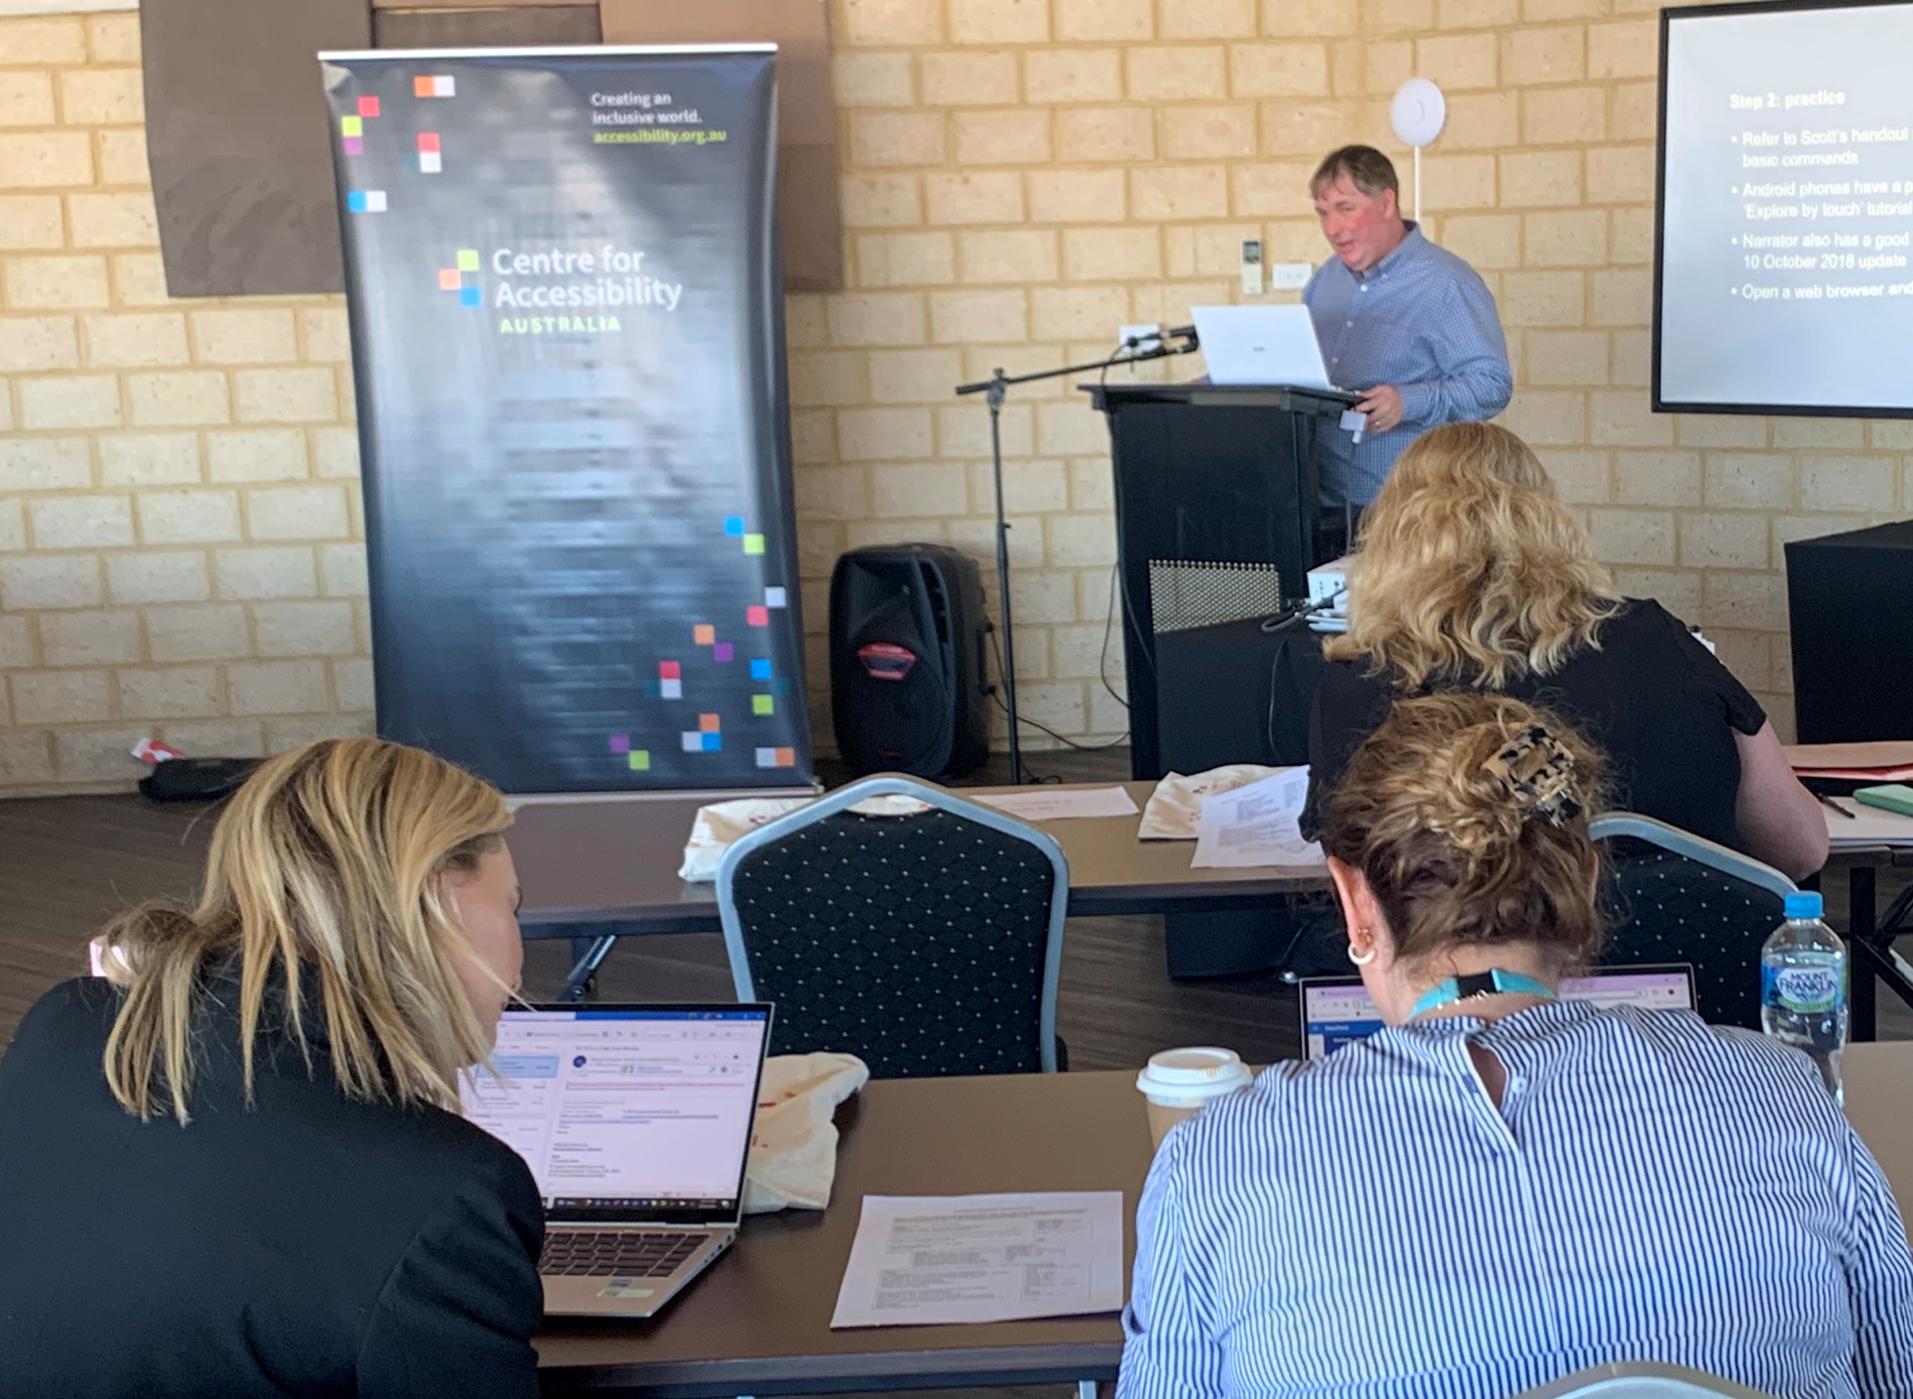
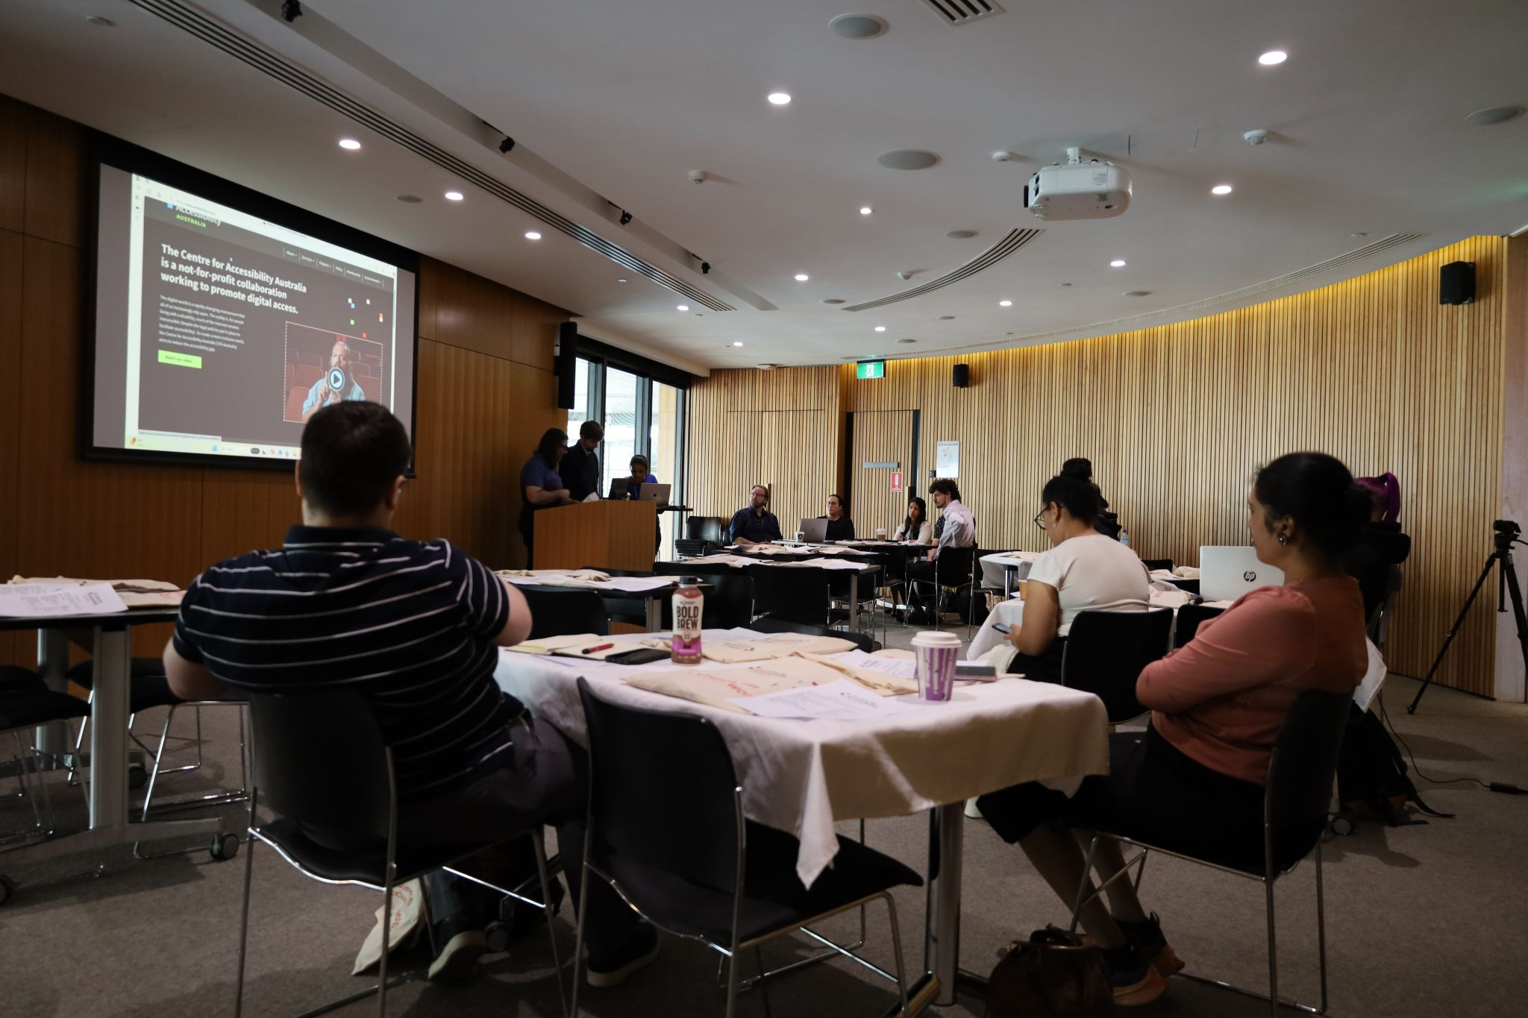
Workshop details
Location & date | Date | Attendance
Perth | April 2023 | 27
Perth (Belmont) | June 2023 | 13
Perth (UWA) | October 2023 | 147
Broome | March 2024 | 12
York | April 2024 | 4
Bunbury | May 2024 | 62
Mandurah | May 2024 | 9
Geraldton | July 2024 | 9
Kalgoorlie | August 2024 | 4
Busselton | September 2024 | 10
Esperance | October 2024 | 3
3x Perth | November 2024 | 90
Total attendees: |  | 390

Slide 34
Discovery workshops – evaluation approach
Evaluation
Pre- and post-workshop surveys were administered to workshop attendees to ascertain changes in knowledge, attitudes and intentions regarding digital accessibility. The survey design was iterative, with questions added throughout the duration of the workshop delivery. Survey results are discussed throughout this section of the report, and a final version of both pre- and post-surveys can be found in Appendix X.
Survey design
Two evaluation surveys were designed for the workshop evaluation – one pre-workshop survey and one post-workshop survey. The surveys were developed by The BCC in consultation with CFA Australia and were approximately 10 minutes duration each. The surveys developed were iterative, with changes made to both surveys to reflect updates in workshop locations and inclusion of videos and hands-on activities. The surveys were administered by CFA Australia prior to and following each of the workshops.
The surveys included both closed and open-ended question types, covering the broad topics of:
Knowledge of digital accessibility
Attitudes towards digital accessibility
Intentions to improve organisation’s digital accessibility
Perceived challenges to improving digital accessibility
The post-workshop survey included questions from the pre-workshop survey to identify changes in attitudes, intentions and knowledge, as well as additional evaluation questions specific to the workshops such as usefulness of the practical components and activities, videos displayed, and ways to improve the workshops.
Sample
A total of 179 responses were recorded for the pre-workshop survey, and 102 for the post-workshop survey.

Slide 35
  Prior to the workshops, over a third of attendees estimated that less than half of their organisations’ websites were accessible for people with disability and close to another third were unable to make any estimation. Only 15% believed that three quarters or more of their website was accessible.
  Despite this, 85% of workshop attendees felt that the accessibility of their website was important to them/their organisation.
Proportion of website accessible prior to workshops
0-25%
26-50%
51-75%
Consider website accessibility to be important
76-100%
Unsure/don’t know
Q How much of your organisation's website do you believe is currently accessible to people with disability (i.e. meets the Web Content Accessibility Guidelines)? Base n=179
Q How important is it to your organisation that your website is accessible for people with disability? Base n=179

Slide 36
  The importance of accessibility to attendees and their organisations is reflected in their reasons for attending the workshops, with nearly one in two attendees motivated to attend by a desire to increase their knowledge about digital accessibility or to learn how to improve the accessibility of organisations’ website and digital assets.
  A quarter of respondents also explicitly mentioned that accessibility for people with disability was important to them personally, their organisation and/or their community.
Reasons for attending workshop
  IN THEIR OWN WORDS
“Accessibility is so important to our organisation as a community centre and we're always wanting to do better. We really wanted real, lived experience information that was recognised as best practice so when I saw this workshop advertised, I jumped on it!!”
“Improve my own understanding of how decisions I make as a developer translate for a person who may be using assistive technology. To learn more about how assistive technology is used. Gather some knowledge I can take back to my team to help inform the importance of designing and developing with accessibility in mind.”
“I have been advocating, practicing and training staff in Plain Language for decades, and wanted to find courses I could direct colleagues to.”
“I have been working with a blind client, and it has opened my eyes to the need for good consistent accessibility for people with disability. I want to embrace as much info as possible to best help our clients.”
“We work in web development and feel accessibility is something we need to integrate into our workforce and to encourage clients to take seriously.”
“Learn more on how we can not only make our website more accessible but be able to tell others in the region”
To gain knowledge/understanding about accessibility/specific topics/plain language
To learn how to improve our accessibility for people with disability
Because accessibility is important to my organisation/community/website users
Relevant to my role
To gain/improve my skills
To promote accessibility to others/teach or train others/share learnings
Asked to attend by manager/organisation
Q In your own words, please tell us why you decided to attend this workshop. Base n=78

Slide 37
  Prior to the workshops, participants were asked to identify their greatest challenges in making their organisations’ websites more accessible. The most frequently cited challenge was lack of capacity, particularly in terms of resource allocation and competing priorities. The second most commonly identified challenge was a lack of experience and knowledge, with respondents noting that either they or their staff lacked the necessary skills.
  Other challenges mentioned included time limitations, budget constraints, being constrained by the organisation’s website design, technological barriers, and a lack of buy-in from management and stakeholders, despite demand and interest from staff at lower levels.
Barriers to improving digital accessibility (Top 6)
  IN THEIR OWN WORDS
“We have a lot of information and resources and limited human resources to manage.”
“Capacity - we’re a not-for-profit with a small but mighty team.”
“The sheer volume of information we currently have and the funding (staff capacity) to spend time improve it.”
“All the decisions, priority and competing deadlines for staff involved, insufficient team experience in this area, cost, obtaining sign off in a reasonable time.”
“Having no knowledge and never considering the accessibility before. I want to improve so I can be accessible to all potential clients.”
“Mostly a lack of knowledge in the team that designs and hosts our website. I have some control over the content and ensure accessibility where possible, however there is a lack of knowledge in the design team and therefore it puts limitations on the amount of changes I can make. I think overall for our organisation there is a lack of priority put on the accessibility of the website.”
“Time. We have very limited funds. Staff are so busy. Doing updates takes time. Getting permission for changes from board and exec. Getting web designer to make the changes. Educating the web designer.”
“Lack of knowledge, lack of time.”
Lack of organisational capacity
Lack of experience and knowledge
Time limitations
Cost
Website and technological limitations
Lack of buy-in from management and stakeholders
Q. What do you feel is the greatest challenge for your organisation in making your website accessible for people with disability? Base n=179

Slide 38
After completing the workshops, participants expressed high satisfaction with their experiences, with almost all participants feeling like they were able to participate fully in the workshops, that they felt welcome at the sessions and that the workshops met their professional expectations.
Attitudes (Nett: Agree)
You were able to participate fully in the workshop
You were made to feel welcome at the workshop
The workshop met your [professional] expectations
Q. How much do you agree with the following statements? Base: Total n= 102

Slide 39
Furthermore, more than 90% of attendees felt that the workshops helped them understand the usefulness of assistive technologies, gave them insights into the WCAG standards and informed them about how to use automated checking tools.
Most importantly, 93% of those who attended a workshop said that they were more likely to act to improve their organisation’s digital accessibility. This last indicator suggests that the learnings from the workshops are likely to be applied by attendees and therefore create a meaningful improvement in digital accessibility for people with disability.
Attitudes (Nett: Agree)
The workshop helped you understand the usefulness of assistive technologies such as screen readers
The workshop gave you insights and guidance on the Web Content Accessibility Guidelines and standards
As a result of the workshop you are more likely to act to improve your organisation’s digital accessibility
The workshop informed you about using automated checking tools
Q. How much do you agree with the following statements? Base: Total n= 102

Slide 40
Workshop attendees were asked about the hands-on activities and practical demonstrations, as well as the videos shown during the workshop. Overall, 93% of respondents agreed that the hands-on activities and practical demonstrations utilised during the workshops were useful.
There was also very high levels of agreement that the videos that were created as part of the Department of Communities WA Grant were a valuable addition to the workshops, with over 90% finding the videos informative, understanding, and enhancing of their understanding of digital accessibility from the perspective of people with a disability.
Attitudes towards the videos (Nett: Agree)
The videos shown during the workshop …
Were informative
Were engaging
Consider hands-on and practical activities useful
Helped you understand digital accessibility from the perspective of people with disability
  Q. How useful were the practical demonstrations and hands-on activities during the workshop? Base n = 84
Q. How much do you agree with the following statements? Base: Total n= 84

Slide 41
The positive impacts of the workshops are evidenced by their effect on attendees’ knowledge. Participants showed significantly higher levels of knowledge of the Web Content Accessibility Guidelines and Standards, the usefulness of assistive technologies and the use of automated checking tools compared to before the workshops.
Knowledge pre- vs post-workshop (Nett: Moderate/high knowledge)
The Web Content Accessibility Guidelines and Standards
The usefulness of assistive technologies such as screen readers
Using automated checking tools
Pre-workshop
Post-workshop
Q. How much knowledge do you feel you have about each of the following aspects? Pre-workshop base n=179; Post-workshop survey base n=102

Slide 42
Even though a high number of participants (85%) already felt that improving their organisation’s digital accessibility was important prior to the workshop, the delivery of the workshops managed to significantly improve the perception of importance of this issue, with 99% of attendees feeling that it was important for their organisation that their website be accessible for people with disability post workshop.
Similarly, despite already high likelihood to act to improve organisation’s digital accessibility prior to the workshops, likelihood to act further increased post workshops, showing that the workshops significantly increased motivation to improve digital accessibility for attendees.
Importance of and likelihood to improve organisation’s digital accessibility
Pre-workshop
Post-workshop
Importance of digital accessibility
(Nett: confident)
Likelihood to improve digital accessibility
(Nett: likely)
Q. How likely are you to act to improve your organisation’s digital accessibility in the next three months? Pre-workshop base n = 179; Post-workshop base n=102
Q. How important is it to your organisation that your website is accessible for people with disability? Pre-workshop base n = 179; Post-workshop base n=102

Slide 43
In terms of how the workshops could be improved in the future, the majority of attendees felt the content and delivery of the workshops to be highly satisfactory as they were and did not make any suggestions for improvement. Among those who did suggest changes, these most frequently related to the venues in which the workshops were held, a desire for more interactivity or hands-on activities during the sessions and clarifications over what to bring (with several not realising they needed to bring headphones or a laptop).
A minority of attendees notes that they would have liked more time to cover the topics in the workshop, or that it could be extended over more session and there were some attendees who requested additional information about applying accessibility techniques and technologies to the social media context.
What could be improved about the workshops?
  IN THEIR OWN WORDS – what could be improved?
Nothing/no suggestions/positive comments
“Hands on exercise/demos for attendees to interact with AT. Shown example of software that is not built correctly that interferes with users’ ability to use AT.”
“I can not remember being asked to bring headphones along with the laptop, the noise in the room could make it difficult for neurodiverse people or people with auditory processing needs to focus.”
“It was hard to see the presenters at times because the room was quite dark.”
“Wanted more information on tools to use and social media specifically.”
It was a very enjoyable workshop. It would have also been helpful for the social media part to be more current (the references to Twitter were a concern) and to see what makes a sound/good social media asset. All that said, it was a useful morning, and I have a lot of ideas to be going on with. Thank you.”
“Would love more specific workshops on what each success criteria in the WCAG guidelines means and how to understand them. Would also love more on how to use a screen reader to test yourself (but in more detail).”
“Before and after example of website and posters that have been made accessible.”
Venue issues - noise, lighting, temperature, catering, technical issues
More interactivity/hands-on activities/ practical tasks
Ask attendees to bring equipment - laptop, headphones
More time needed/detail on specific topics/break into two sessions
Run more workshops/get more people to attend
More information specific to social media
Examples of best practice/before and after/ good and poor implementation
Add introductions/housekeeping/ ice-breaker activities
Provide hand-outs/copies of slides to take away
More assistance during activities
Q. What are all the ways we could improve the workshop to better meet your needs? Base n=102

Slide 44
Attendees from the workshops were approached for qualitative feedback several months after participating, to understand what, if any impacts their learnings form the workshops had on their organisation. As can be seen from the responses below and overleaf, participants were overwhelmingly positive in their feedback on the workshops. Attendees described the value in being able to apply their learnings to the benefit of their organisations (and people with disability) and share their knowledge and skills with others.
“
  IN THEIR OWN WORDS – what positive impacts have the workshops had?
“I truly enjoyed the workshop and learnt many essential tips on designing websites to be accessible to everyone. You helped me broaden my perspective and save a lot of time I would otherwise have needed to learn from scratch. Based on your training, I started implementing changes to my research website.
“I found the workshop to be incredibly informative, yet easy to understand. The resources I took home are easy to follow guides which have been very useful in my professional life, and personal life too. I have a new view on accessibility in a digital era and hope that the organisation is supported to deliver more free training in the regions.”
“After attending the training, I have made a more educated and concerted effort to make our content, particularly on social media but also print media, more accessible. We have seen increased engagement with posts since including more appropriate and comprehensive alternate text for images and decrease in queries since creating more accessible ‘plain English’ FAQs and information sheets for our programs. This training solidified and explained simple concepts that have made improvements easy to implement without too much time burden.”
"The workshop really opened my eyes to be much more aware of the differences in consumers' needs when it comes to online content, in both design and language choices. I'm feeling much more confident in my plain language writing skills and look forward to the chance to use these more.”
“As a communications and engagement officer, it was fantastic to have the opportunity to learn about Digital Accessibility. My prior knowledge was minimal so I was very keen to learn more about how I can improve both personally and professionally online. Since the workshop, I have also been able to share what I learned with my colleagues. Through spreading the word about my learnings, I hope to drive improvement in accessibility in my organisation. I cannot thank the Centre for Accessibility enough for the fantastic opportunity to attend these workshops. I learned so much.”
“The Digital Accessibility workshop was really helpful to me and our organisation as I could immediately apply things that I learnt to support our digital access goals. The workshop presenter was very knowledgeable and gave lots of helpful tips and strategies as well as providing some great foundational knowledge about best practice and the web accessibility guidelines. We are very passionate about removing barriers to digital access and these workshops are an excellent way to inform and support positive change, not just within the disability sector, but across community and mainstream organisations. This work is critical. We hope to attend more events in the future. Thank you.”

Slide 45
“
  IN THEIR OWN WORDS – what positive impacts have the workshops had? (cont.)
“I recently attended the Digital Access workshop in Esperance, and I was truly impressed by the wealth of insightful information shared. As someone in a wheelchair with significant involvement in the disability sector, I thought I already had a good understanding, but the workshop taught me so much more. The knowledge I gained is already helping us improve our website, making it more accessible for people with vision impairments and other disabilities. I'm extremely grateful for the opportunity to attend locally in Esperance, rather than having to travel elsewhere.”
“I found the workshop highly beneficial. It gave me the opportunity to learn about the tools that can help us monitor our accessibility and show how where we can improve our websites. We are still working through a lot of changes to optimise both the accessibility and performance of all our websites.”
“The things I learnt at the Digital Accessibility workshop helped me to appreciate the positive impact that thoughtful changes in communication processes can help make it more accessible to everyone. It was great to take home practical tips and resources and to feel more informed about digital accessibility issues.”
“The workshops was specific and practical. The topics were broken up into theory, hands on practical experiences e.g. using speech support tools on your phone or laptop as well showing case studies/examples of facilities that had issues and how they could be improved. This workshop made the learning relatable and being able to complete within the southwest meant that the other attendees from other organisations were experiencing similar issues and we could relate to each other, it was also nice know talking to other people from the southwest because I could make connections quicker as I had an awareness of their organisation, and we could extend conversations much quicker because of geographical relations.”
“I would have to say that getting a definition of open captions vs closed captions has been monumental in ensuring our department’s content is as accessible as humanly possible. A big thank you to everyone involved in making the presentation happen.”
“Just being able to see how our website looked accessibility wise was a learning for us. We have begun to make changes, as funding allows, to ensure it’s as accessible as it can be.”
“This was a really helpful workshop. It has inspired me to make sure we put image descriptions on all of our images on our website and Facebook pages.”

Slide 46
Part 4: Introduction to inclusive design course

Slide 47

Introduction to inclusive design course
Background
CFA Australia and the University of the Sunshine Coast (UniSC) co-created a free, six-module course on digital accessibility called the Introduction to Inclusive Digital Design (IDD) short course. The course was launched on June 4, 2024, and was developed to address the diverse challenges individuals face when accessing digital content. The course was designed to provide participants with comprehensive insights into accessibility issues and to equip individuals with the necessary skills and knowledge to ensure their digital content meets legislative and regulatory requirements.
Delivery
The free online course, delivered through UniSC, was delivered flexibly online over eight weeks on a part-time basis. The course covered six modules:
Understanding Inclusive Design and Accessibility
Business Case for Inclusive Design
Legislative Requirements
Analysing Accessibility of Business Documents
Creating Accessible Microsoft Office Documents
Creating Accessible PDF Documents

Slide 48
Introduction to inclusive design course
Evaluation
A pre-course survey was administered to students enrolled in the course prior to commencing the modules, while a post-course survey was administered to students who completed the course. A total of 711 students were recorded as enrolled in the course, with 70 having completed it.
It should be noted that while the IDD course was not a deliverable formally associated with the Department of Communities WA Grant and the evaluation of this, CFA Australia and The BCC felt it would be a valuable addition to the work being done as part of the grant to evaluate the course and provide recommendations for future similar work by CFA Australia.
Survey design
The surveys were developed by The BCC in consultation with CFA Australia and UniSC and were approximately 10 minutes duration. The surveys were administered by UNiSC. The surveys included closed and open-ended questions, covering the topics of:
Knowledge of digital accessibility
Attitudes towards digital accessibility
Intentions to improve digital accessibility
Assessment of course content and utility
Suggestions for course refinement and improvement
Sample
A total of 174 responses were recorded for the pre-course survey, and 37 for the post-course survey.

Slide 49
Prior to starting the IDD course, those who enrolled were asked where they had learned about the course, with a plurality having seen the it advertised, promoted or mentioned on social media (42%). Nearly a quarter had learned of the course through someone they knew (23%) and around 1 in 10 had heard of it through CFA’s newsletter (11%) or through UNiSC staff or website (10%).
The vast majority of those who enrolled in the course did so independently (85%), rather than on behalf of an organisation.
Where learned about the IDD course
Social media
Through a friend, family member, or colleague
The Centre for Accessibility Australia’s newsletter
Through a University of the Sunshine Coast staff member or website
Search engine
Enrolled independently
Online ad
Other
Q1 - How did you hear about the Introduction to Inclusive Digital Design short course? Q2 - Did you enrol in this course on behalf of an organisation? Base: Total n= 174

Slide 50
  Prior to the course, participants were asked to identify their greatest challenges in making digital technology accessible for people with disability. The most frequently cited challenge was a lack of knowledge (33%), either personal knowledge or knowledge within an organisation. The second most commonly identified challenge was a lack of priority given to accessibility in an organisation (26%). This was described in terms of both leadership, but also a lack of perceived importance across all staff levels.
  Other challenges mentioned included a lack of time and resources (18%), financial constraints (9%), the need for and access to training about implementing digital accessibility (9%), a lack of skills and experience (7%), challenges around complexity and the need to account for a range of disabilities (7%) and the need to remake and maintain content (4%).
Barriers to improving digital accessibility (top 8)
  IN THEIR OWN WORDS
“Lack of resources, knowledge and experience in this field. Perhaps the greatest challenge is lack of Executive advocacy.”
“There should be no issue in making disability accessible given the nature of the organisation, but there is often resistance to change, and the majority of staff do not engage in additional training to update their skills.”
“One of the challenges is training, not everyone has the knowledge about it, and sometimes companies don’t invest in training. Another one is that there is a miss conception that is something that you add “on top”, at the end of the project. And lastly is costs. It’s seen as an “extra cost”. As if it were an “edge case”, when is clearly not an edge case. Is being inclusive.”
“The rapid pace of change and the sheer number of tools in the ecosystem that we need to consider. This coupled with the level of staff knowledge in this area and the upskilling that is required.”
“Educating employees, making resources available, communicating why this is important.”
“The greatest challenge is making digital technology accessible yet still attractive and appealing. There is also so many disabilities and allowances to be made.”
Lack of knowledge
Accessibility not given priority/importance/need to convince others of importance/resistance to change
Lack of resources/time
Lack of funding/willingness to invest in accessibility
Access to and accessibility of training and resources/ training staff
Lack of experience/skills/expertise
Complexity/volume of change/the need to account for a range of disabilities
The need to remake content/keep content complete/up to date/maintained
Q. What do you feel is the greatest challenge for your organisation in making your website accessible for people with disability? Base n=174

Slide 51
Among those who completed the course, their reported experiences of it were overwhelmingly positive, with all aspects of the course content and format rated extremely highly.
All the 37 respondents felt that the course content was useful and the online format easy to navigate. Only slightly fewer found the content to be interesting (97%), relevant (97%) and engaging (95%).
How much do you agree that … (Nett: Agree)
The course content was useful to me
The online format was easy to navigate
The course content was interesting to me
The course content was relevant to me
The course content was engaging
Q. How much do you agree with the following statements? Base n=37

Slide 52
Additionally, the effects of the course on topic knowledge and understanding were very highly rated, with more than 90% of those who completed the course feeling that it had increased their understanding of all content areas.
Particularly strong were the course topics of the use of automated accessibility tools and using POUR design principles, with all course graduates reporting that they had increased their understanding in these areas.
The aspects in which the course was felt to deliver marginally less improvement in understanding (though still rated at 92%), were the WCAG standards and the use of assistive technologies.
To what extent do you agree that your understanding of each of the following topics has improved due to the course? (Nett: Agree)
Using automated accessibility checking tools
Using POUR design principles
Creating accessible Microsoft Office documents
The importance of inclusive design for business
The WCAG accessibility principles for documents and interfaces
Creating accessible Adobe PDF documents
The Web Content Accessibility Guidelines (WCAG) and standards
The usefulness of assistive technologies such as screen readers
Q. To what extent do you agree that your understanding of each of the following topics has improved due to the course? Base n=37

Slide 53
The IDD course had very positive impacts on graduates’ self-reported knowledge of digital accessibility overall, with this increasing significantly pre vs post course completion (62% to 82%).
The course was even more effective in raising graduates’ confidence in their skills to improve digital accessibility for people with disability. Prior to the course, less than half of those enrolled felt confident in their skills (46%). Among course graduates, this rose significantly and substantially to 97% who felt condiment in their skills in digital accessibility.
These results are extremely positive as an improvement in both knowledge and confidence suggests graduates will be effective in implementing course learnings going forward.
Knowledge and confidence about digital accessibility
Pre-course
Post-course
Knowledge of digital accessibility
(Nett: moderate/a lot)
Confidence in skills to improve digital accessibility
(Nett: confident)
Q. How much knowledge do you have about digital accessibility? Pre-course base n= 174; Post-course base n=37
Q. How confident are you that you have the skills to improve digital accessibility for people with disability? Pre-course base n= 174; Post-course base n=37
Notes:
Flip to columnn

Slide 54
Despite strong improvements in knowledge and confidence, there was only improvement in one area of application of learning, with students in the course more likely to monitor the accessibility of their organisation’s digital assets after completing the course (92%), compared to at enrolment (87%). However, it should be noted that comparability in this area may be compromised by the low sample size of course graduates, combined with a high proportion of graduates (compared to enrolees) saying that the prompted applications of the course content were ‘not applicable’ to them.
If the course is to be continued/re-run, it is recommended that these indicators be revisited with a more representative sample of graduates.
How likely are you to do each of the following… (Nett: likely)
Not applicable
Monitor the accessibility of your organisation’s website/digital assets
2%
5%
Commit to maintaining a high level of accessibility of your organisation's website/digital assets
3%
8%
Take action to ensure all new content on your/your organisation’s website is accessible
2%
11%
Ensure relevant staff are trained to understand and implement accessibility principles on your organisation’s website/digital assets
6%
19%
Pre-course
Post-course
Q. How likely are you/your organisation to do each of the following in the future to improve accessibility? Pre-course base n=174; Post-course base n=37

Slide 55
When asked about the most valuable insight or skill gained from the course, those who had completed the course most commonly highlighted a better understanding of the technical elements of digital accessibility and how to make documents accessible. Other key themes included the practical demonstrations, improved understanding of the POUR principles and WCAGs, and increased awareness of legal obligations and the broader impact of digital accessibility.
Most valuable insight or skill gained from the IDD course (Top 7)
  IN THEIR OWN WORDS – most valuable insights
“The practical tips to ensure documents are accessible, as well as the break down of the WCAG into simple principles. I also really like the explanation of the difference between inclusive design, accessibility and universal design. Makes sense!”
“The overall lack of compliance of organisations, especially those providing services within the Disability sector. The examples, including challenges of the Sydney Olympics, were extremely insightful and show the lack of large organisations with considerable government support to comply to basic Human Rights”
“It was very useful to have screen recordings walking through how to correct accessibility issues in Word and Adobe Acrobat Pro. This helped explain the tag tree and how to edit elements”
“That a small amount of effort on my part, can have a huge impact on the accessibility of a document”
“That there is a legal obligation for employers/organisations to ensure that their content is accessible for disabled people. Given that the tools are readily available it is extremely disappointing that possibly due to lack of knowledge, most organisations are failing at this obligation”
Understanding technical elements of digital accessibility
Learning how to make documents accessible
Practical explanations and demonstrations
POUR Principles
Legal obligations
WCAGs
The impact of digital accessibility
  Q. What was the most valuable insight or skill you gained from this course? Base n=37

Slide 56
In terms of how the course could be improved in the future, half of those who completed the course did not make any suggestions for improvement or made positive comments about the content and delivery.
Among those who did suggest changes, these most frequently related to the videos used in the course, with several students commenting that they would like these to have been shorter and/or more engaging. Others also noted that the content was sometimes unclear or obscured in certain viewing modes.
There were also some requests for additional activities or hands-on practical tasks in the course, as well an increased focus on accessible language in the content.
What could be improved about the IDD course?
  IN THEIR OWN WORDS – what could be improved?
“Nil, think this was a great course and incredible marketing for the university.”
“It was great as is. Thanks for the opportunity to complete it.”
“Perhaps the videos could be made into interactive videos to allow some time to pause, and knowledge check the information as it is delivered.”
“When the instructor went through accessible word or pdf, I couldn't see their curser so i was unsure where some of the tabs were located.”
“I prefer to watch videos in page (rather than full screen) and found that the controls covered faces and names of the teaching staff in this view.”
“The videos were hard to follow at times as it was hard to see what was happening on the screen. I would have also loved some worked examples and step by step instructions to be able to refer back to.”
“The video's that showed the PDF tools were very long and if I want to be successful, I'd need to watch them step by step as I did one, several times.”
“Perhaps more of the activities where we download and test, practical tasks.”
“More practical skills. I learn by doing.”
Nothing/no suggestions/positive comments
Make videos more engaging/shorter/more interactive/examples
Interaction tools with videos (keyboard, shortcuts) obscured content/were unclear
More activities/practical/interactive tasks
More content about accessible language/ instructional text
Elements not relevant to me/my work
Other
Q. What suggestions do you have for improving the course going forward? Base n=37

Slide 57
Findings and recommendations

Slide 58
Summary of key findings and recommendations
Part 1: Program logic workshop summary
Upon receipt of funding approval from the Department of Communities WA, The BCC recommended all parties come together to clearly define the purpose of the project, and to identify clear program goals and measures. The program logic workshop provided excellent foundations upon which to build the evaluation plan. However, it may have provided more value had it been used to help shape the funding application itself.
The theory of change articulated for the project in this workshop was “We will achieve an increase in the number of organisations that have implemented and are committed to maintaining digital accessibility by addressing a lack of understanding, commitment and capability to implement accessibility principles through engaging with and training organisations to make their digital assets accessible”. Working with key stakeholders, including DoC, to develop the theory of change was valuable because it contributed to a shared understanding of project direction, and desired outcomes.

Slide 59
Summary of key findings and recommendations
Part 2: Audit-to-Implementation Roadmaps summary
Representatives from organisations that took part in CFA’s audit process almost universally felt it to be informative and that it provided clear guidance about how to increase their digital accessibility.
The positive impacts of the process were evident in substantive gains in knowledge about digital accessibility and confidence to improve the digital accessibility of organisations’ websites.
Participants in the audit process also showed a significant increase in the proportion of their organisation’s website that was accessible after having the opportunity to implement the actions indicated by their roadmap.
Despite very positive indications in participants’ knowledge and confidence, there was not a similar gain the extent to which organisation representatives felt able to commit to maintaining high levels of accessibility, or to ensure that all new content would be accessible. Participants noted that they felt particularly challenged in this area by limited capacity and resources to dedicate to accessibility.
Following completion of the audit process, more than 90% of respondents believed that website accessibility is important, showed very high levels of satisfaction with the audit process, and were almost universally likely to recommend the audit process to other organisations.
In terms of how the audit and roadmap processes could be improved in the future, many participants felt the process and outputs were already highly satisfactory, however, there were some suggestions that the recommendations and actions in the roadmap could be made simpler to understand for lay-people and a desire for benchmarking of results to enable understanding and comparability. A small number of participants encountered some delay in receiving their audit and therefore suggested an improvement in communication and timeliness.
Overall, participants sentiments towards the audit process were overwhelmingly positive, with many grateful for the opportunity to participate in the process free of cost due to the support of the Department of Communities WA grant.

Slide 60
Summary of key findings and recommendations
Audit-to-Implementation Roadmaps recommendations
It is clear from the findings that the audit process had very positive impacts in terms of knowledge, confidence, attitudes and intentions of those who took part in it. However, there are some aspects of the process that could be refined to further improve them going forward:
Consider providing benchmarking information as part of the audit process (once sufficient data is available) that allows organisations to understand their performance relative to others (particularly other organisations in their sector).
Provide of examples of ‘best practice’ or ‘best in class’ websites that organisations can look to for examples and inspiration.
Where possible, express recommendations in simple terminology that can be understood by those without technical expertise.
A small minority of those who took part felt in the audits felt that the communication during the audit process and receipt of the audit outputs could have been timelier. While it is likely that this occurred early in the development of the audit process whilst processes and outputs were still being developed, it remains important for CFA Australia to continue to focus on good communication and timely delivery of outputs for any audits that take place in the future.
Finally, most of the organisations that participated in the audit process cited a lack of organisational time and resources as a critical factor that limited their ability to fully implement and maintain digital accessibility going forward. In response to this, CFA Australia could explore funding mechanisms that would allow it to provide such services directly to smaller organisations, and those in the not-for-profit sector who are unlikely to ever be able to dedicate resources to accessibility in a meaningful, ongoing way.

Slide 61
Summary of key findings and recommendations
Part 3: Discovery workshops summary
Participants in CFA’s Discovery Workshops showed high satisfaction with their experiences, with over 90% feeling it met their expectations and almost saying they felt welcome and were able to participate fully.
The hands-on and practical activities in the workshops were felt to be useful, and the videos shown in the workshops that were developed as a part of the grant delivery were very highly rated in terms of being informative, engaging and aiding understanding of digital accessibility.
As a result of their workshop attendance, participants showed significant improvements in their knowledge of the WCAG standards, and the use of automated checking tools and assistive technologies.
Even though most participants already felt that improving their organisation’s digital accessibility was important prior to the workshop, the delivery of the workshops managed to significantly improve the perception of importance of this issue further, with 99% of attendees feeling that it was important for their organisation that their website be accessible for people with disability post workshop (compared to 85% prior).
Similarly, participants’ likelihood to act to improve their organisation’s digital accessibility also increased significantly following the workshops, with 95% likely to make improvements going forward.
In terms of how the workshops could be improved in the future, many participants felt the content and delivery of the workshops to be highly satisfactory as they were , there were some suggestions that aspects of the venues could be improved, a desire for more interactivity or hands-on activities during the sessions and clarifications over what to bring to the workshops.
Qualitative feedback following the workshop program from participants was overwhelmingly positive, with attendees highlighting the positive impacts on themselves and their organisations. Many noted that they had already been able to implement learnings and share the knowledge and skills with others.

Slide 62
Summary of key findings and recommendations
Discovery workshops recommendations
While workshop feedback was overwhelmingly positive, there are several refinements and additions to the content that could be considered to improve them going forward:
Where feasible, consider a pre-workshop visit to ensure potential venues are appropriate, including review of sound and light systems, temperature control, catering offerings, access to technical support and infrastructure.
Ensure pre-workshop information for participants clearly requests that they bring their own laptop, and that headphones are highly recommended, particularly for anyone with sensory sensitivities.
Consider take-home resources, including copies of key slides presented during the workshops for attendees to refer to later.
Consider enhancing the workshop content with (further) opportunities for attendees to use Assistive Technologies themselves. Or instruction on how to use them to assess/test current levels of accessibility.
Consider adding/reviewing content relating to accessibility and social media as more information and more up-to-date information on this topic was desired.
Practical and hands-on activities were highly valued. Continue to incorporate and expand where possible.
Consider adding additional workshop facilitators to assist attendees during practical activities.
Participants were keen to see examples of applied best practice. Consider integrating examples of digital accessibility that has been applied well. Or before and after examples.
Finally, there may be an appetite for alternate workshop offerings, for example longer sessions (delivered over two days) or workshops tailored for an in-depth dive into more specialised topics. For example, a workshop on each of the WCAG standards and how to meet them. A workshop on accessibility in communications (social media in particular) is also likely to be well-received.

Slide 63
Summary of key findings and recommendations
Part 4: Introduction to Inclusive Design Course (IDD) summary
There was good initial interest in the IDD course, with a total of 711 students had enrolled, with those enrolled most commonly finding out about the course through social media, or via a friend, family member or colleague. However, at the date of this report, only 70 of those enrolled had completed the full course.
Among those who completed the course, their reported experiences of it were overwhelmingly positive, with the course content and format rated extremely highly in terms of being useful, easy to navigate, relevant and engaging.
Furthermore, the effects of the course on topic knowledge and understanding were very highly rated, with more than 90% of those who completed the course feeling that it had increased their understanding of all content areas.
The IDD course was effective in increasing graduates’ knowledge of digital accessibility, with more than 80% feeling they had good knowledge of the area following the course.
It was even more effective in raising graduates’ confidence in their skills to improve digital accessibility for people with disability. Prior to the course, less than half of those enrolled felt confident in their skill, with this rising to 97% post-course.
The likelihood of students to take actions within their organisation did not substantially improve following the course, however, it should be noted that comparability in this area may be compromised by the low sample size of course graduates, combined with a high proportion of graduates (compared to enrolees) saying that the organisational actions were ‘not applicable’ to them.
Graduates felt that some of the most valuable insights and skills they gained from the course related to their understanding of the technical elements of digital accessibility and how put these into practice.
In terms of how the course could be improved in the future, half of those who completed the course did not make any suggestions for improvement or made positive comments about the content and delivery. The suggestions that were made included making course instructional videos shorter and/or more engaging, as well as requests for additional activities or hands-on practical tasks.

Slide 64
Summary of key findings and recommendations
Introduction to Inclusive Design Course (IDD) recommendations
The graduates of the IDD course gave extremely positive feedback about their experiences of the course content, with strong impacts on knowledge, confidence and likelihood to apply learnings and skills going forward. Based on the evaluation findings, the course could be refined and improved with some minor adjustments, such as:
Making videos more engaging by shortening length, breaking into sections and/or introducing hands-on/practical tasks within them.
Introducing more hands-on, interactive or practical activities.
Beyond the evaluation, the higher priority for the IDD course is to lift the course completion rate. It was notable that the course received a high number of enrolments, but that (to date) only around 10% have graduated the course. While we do not have direct data to inform the reasons for this low completion rate, potential strategies that could be explored to increase the conversion from enrolment to completion could include:
Greater targeting of course promotion to people and roles for whom the content is likely to be relevant, including through identified organisations.
Provision of a detailed course content overview to potential enrolees to allow them assess for themselves if the content is relevant to them.
Introduction of a nominal course fee to serve as a commitment device for course completion.
If the course is to be continued/re-run, it is recommended that the evaluation also be repeated so that some indicators that were compromised by small sample sizes can be revisited with a more representative sample of graduates.
There may also be merit in adding additional evaluation questions that ask graduates how they intend to apply their learnings (in an open-ended format) to enable further refinements to course content, communication and promotion.

Slide 65
Appendices: Questionnaires

Slide 66
Appendix 1: Pre-audit survey

Slide 67
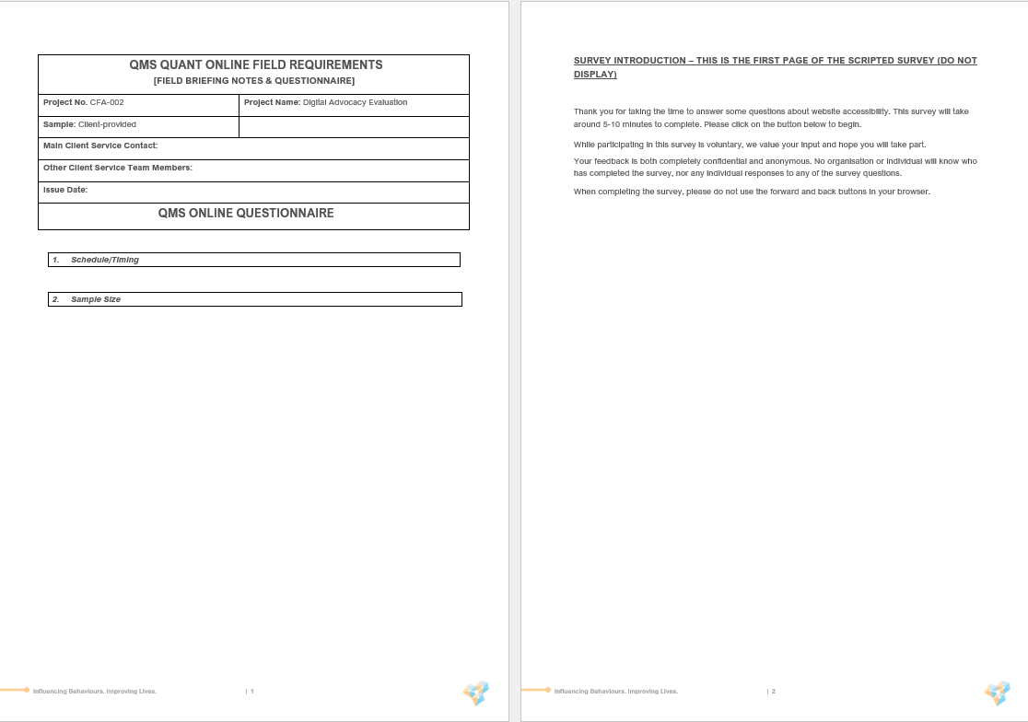

Slide 68
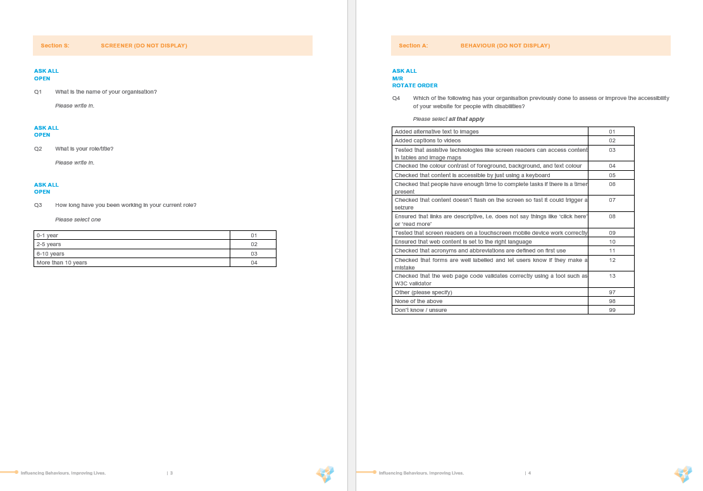

Slide 69
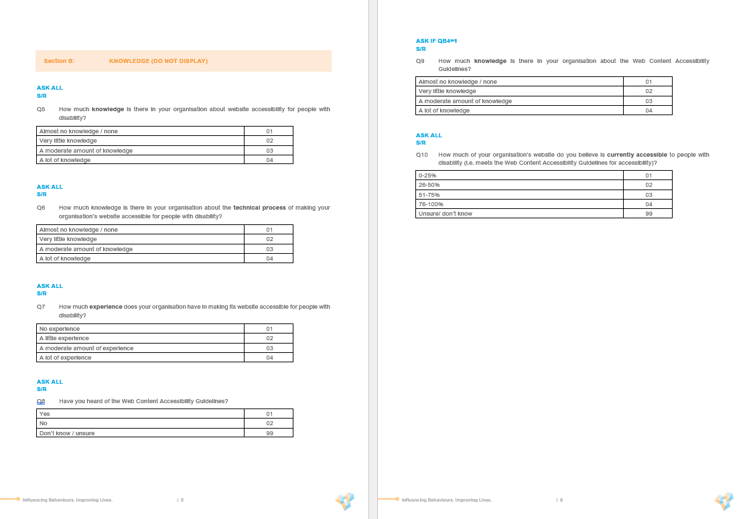

Slide 70
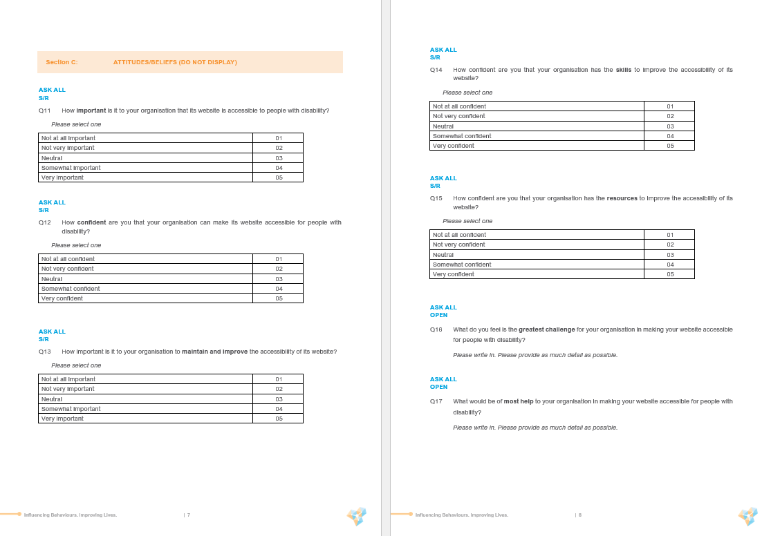

Slide 71
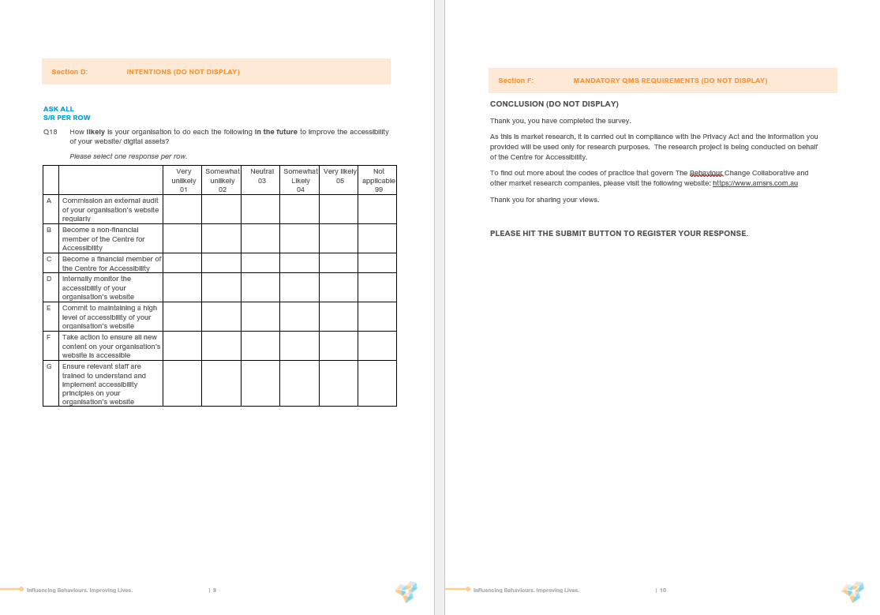

Slide 72
Appendix 2: Post-audit survey

Slide 73
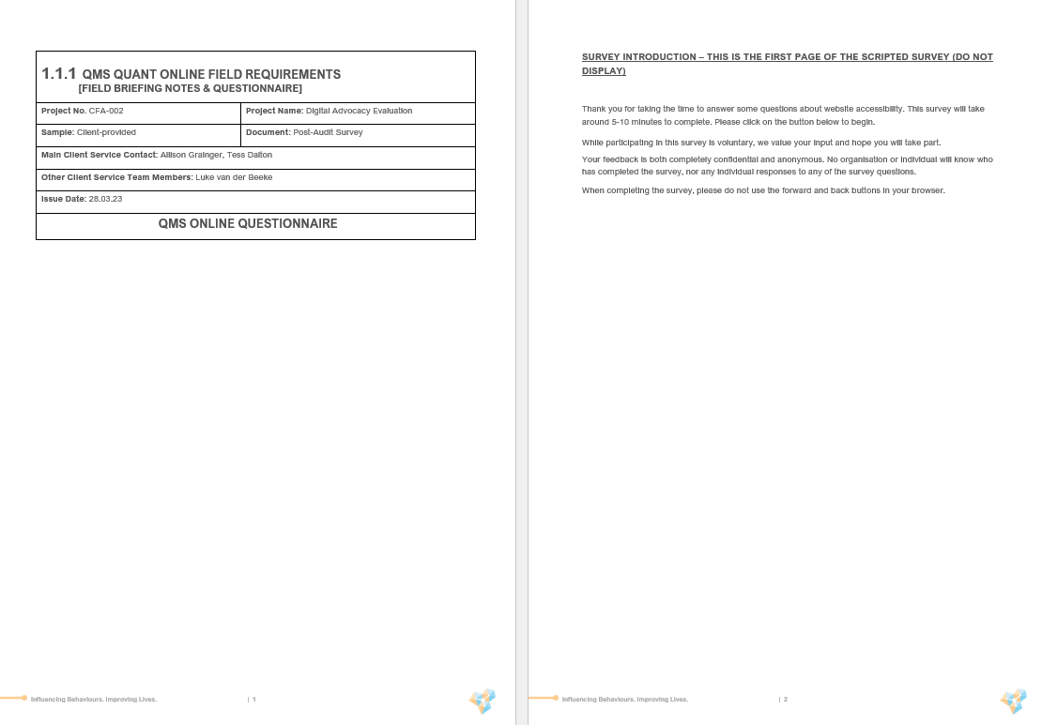

Slide 74
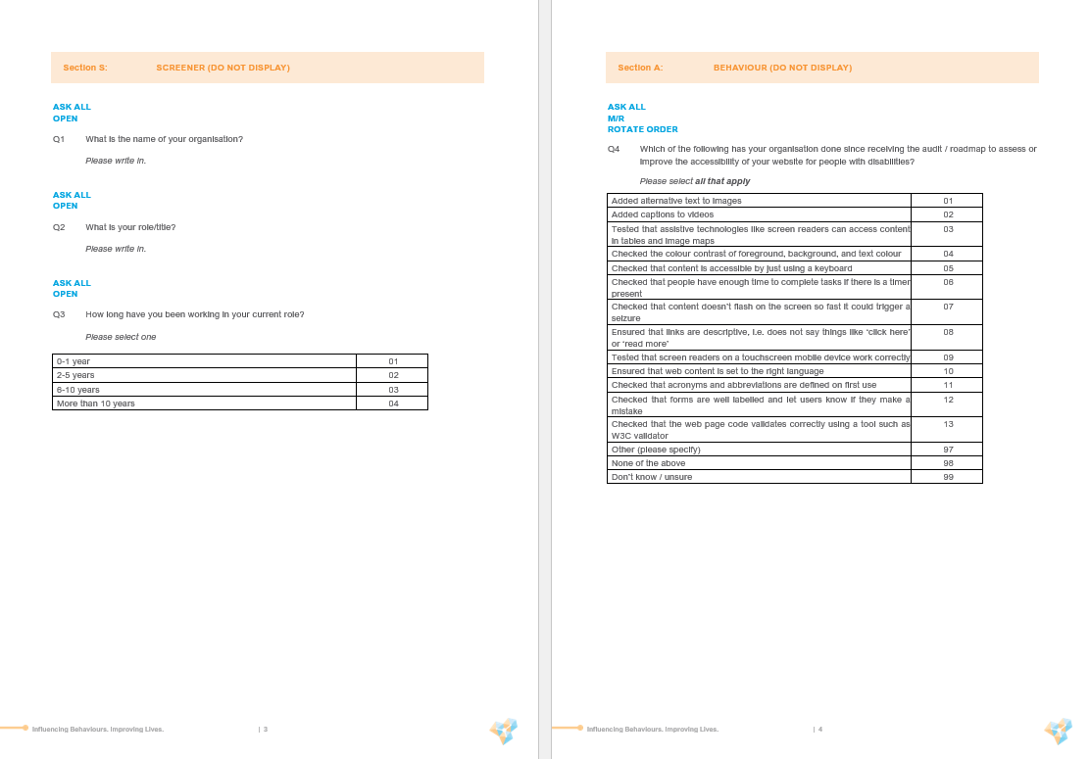

Slide 75


Slide 76
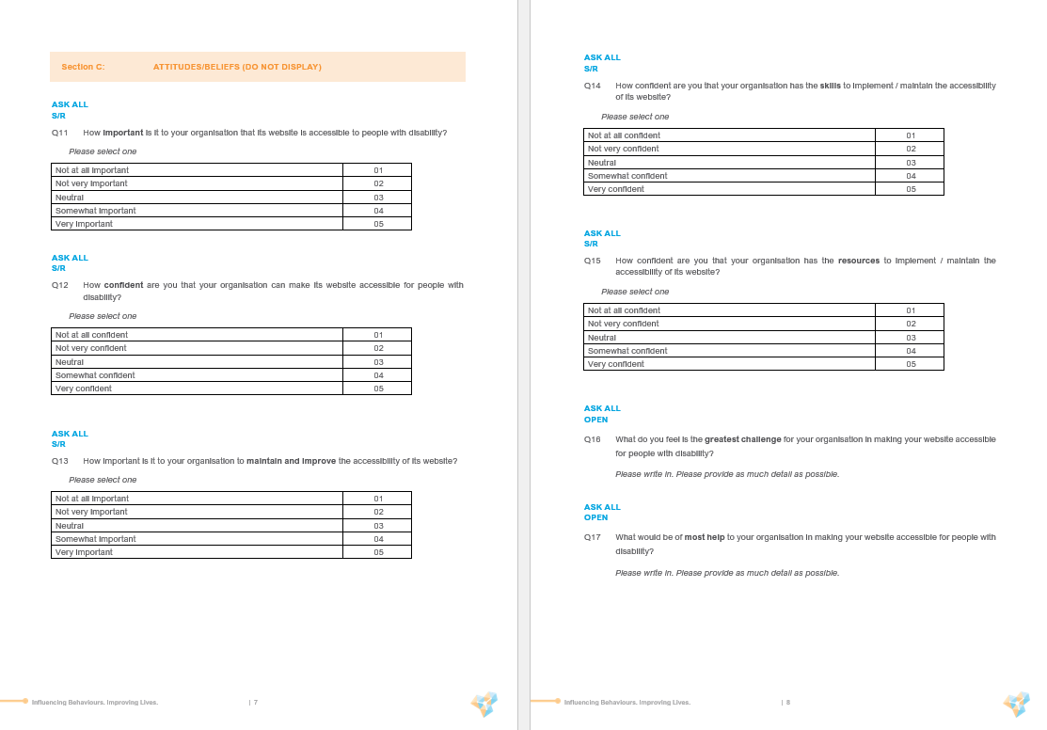

Slide 77
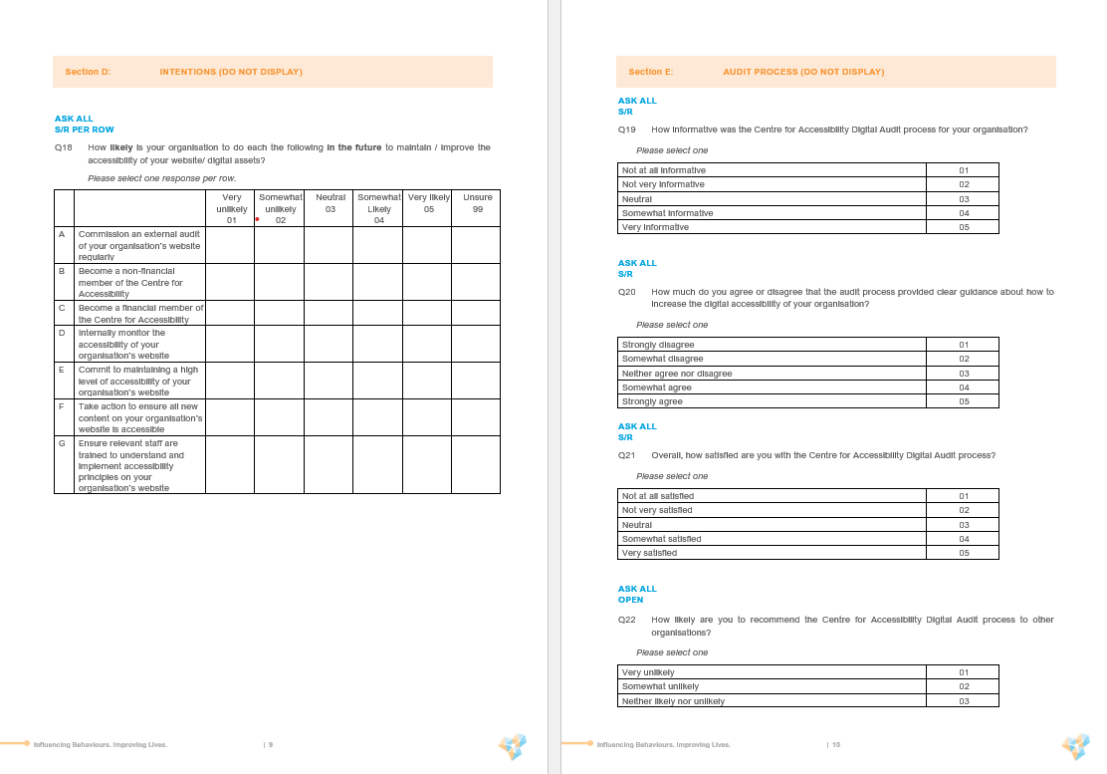

Slide 78
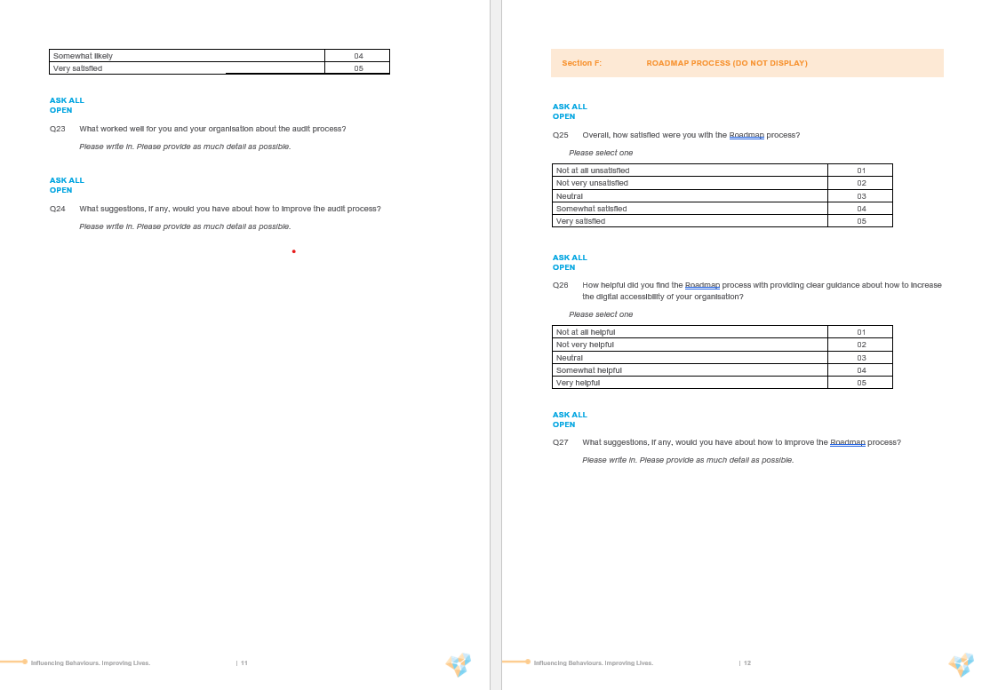

Slide 79
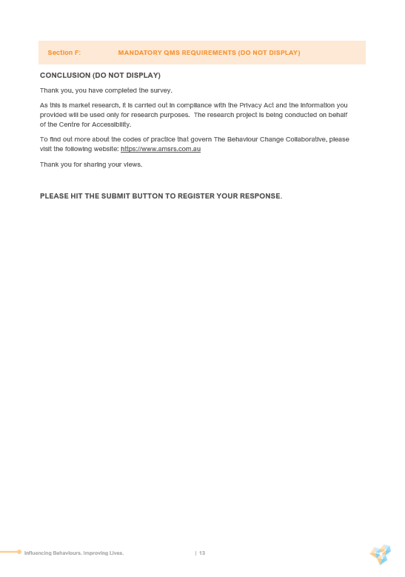

Slide 80
Appendix 3: Pre-workshop Survey

Slide 81
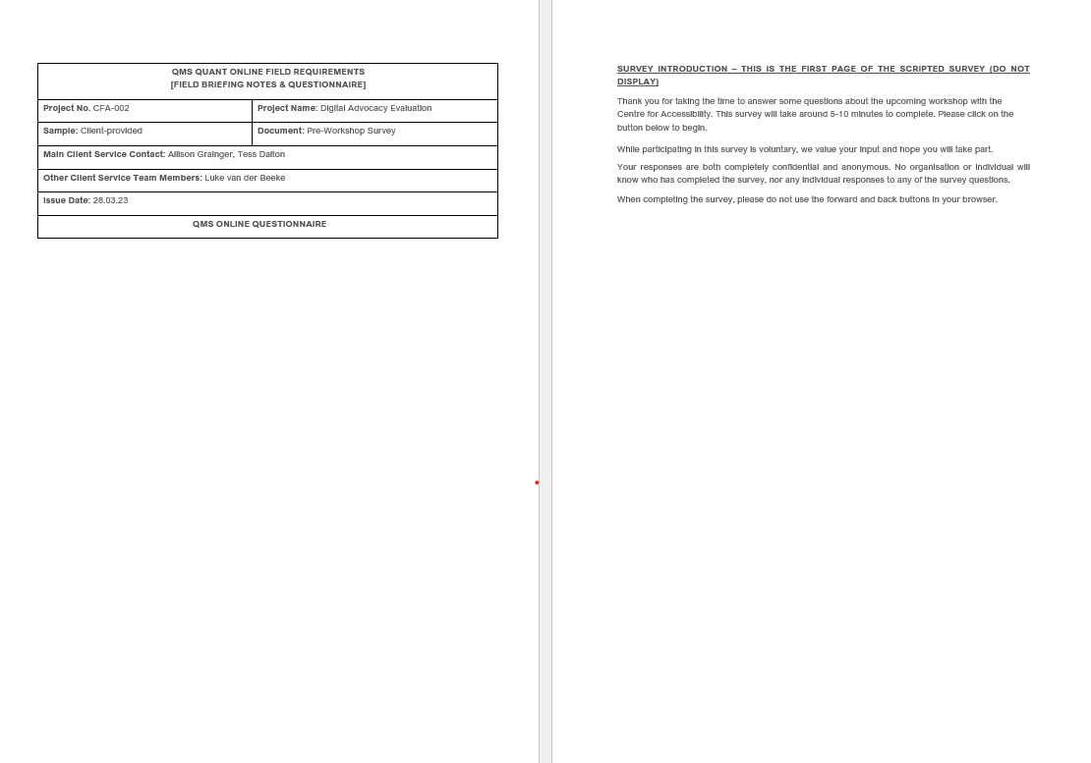

Slide 82
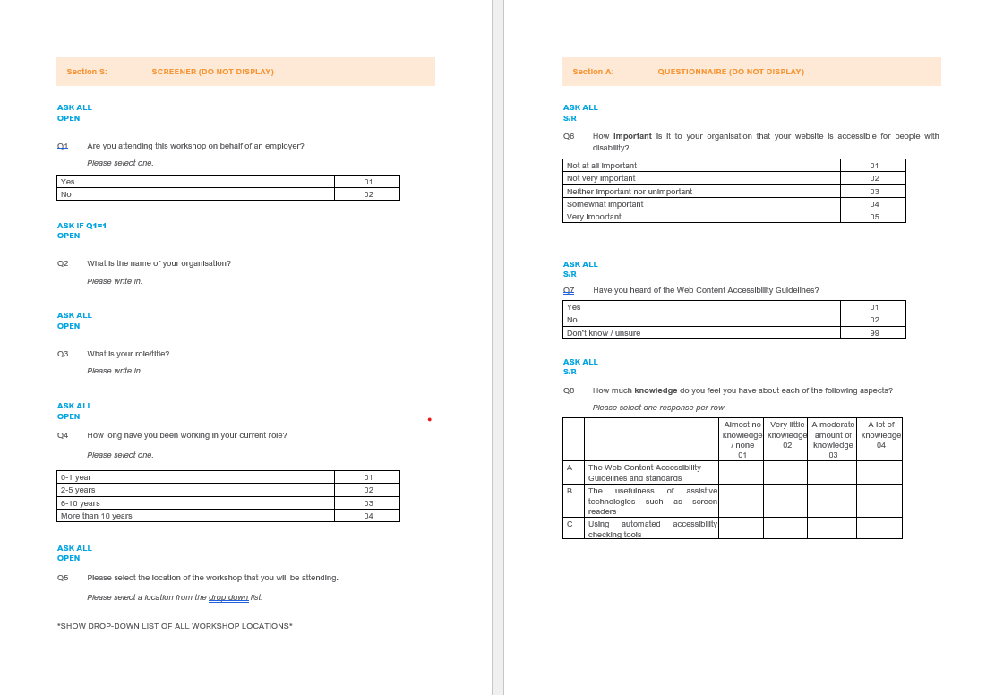

Slide 83
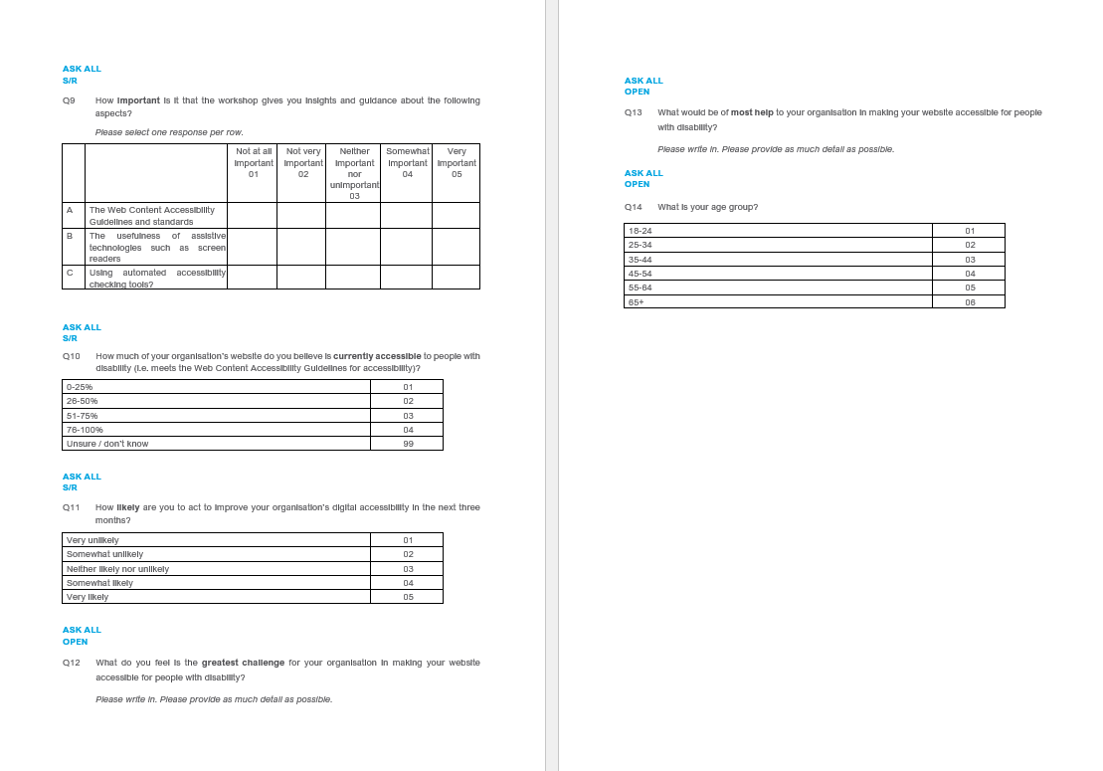

Slide 84


Slide 85
Appendix 4: Post-workshop survey

Slide 86
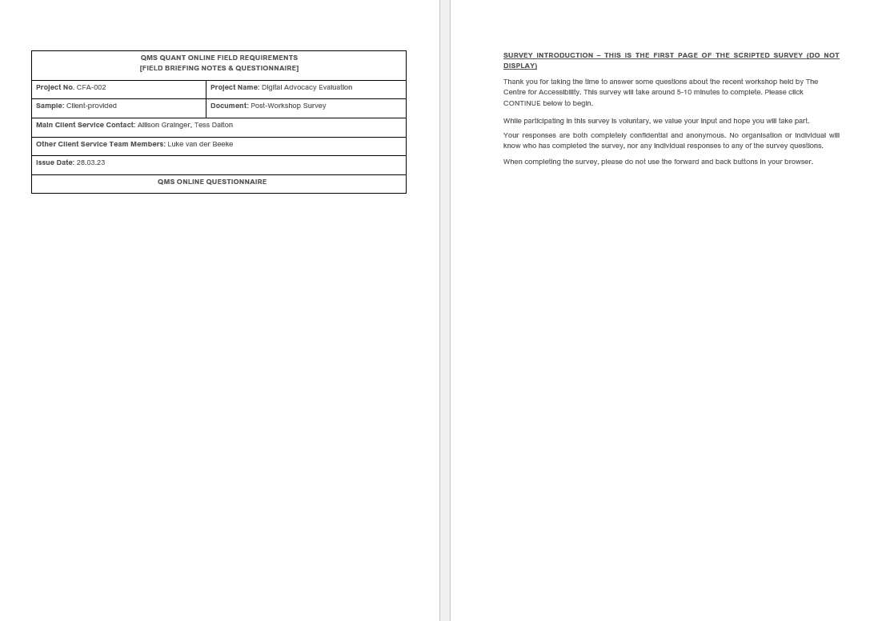

Slide 87
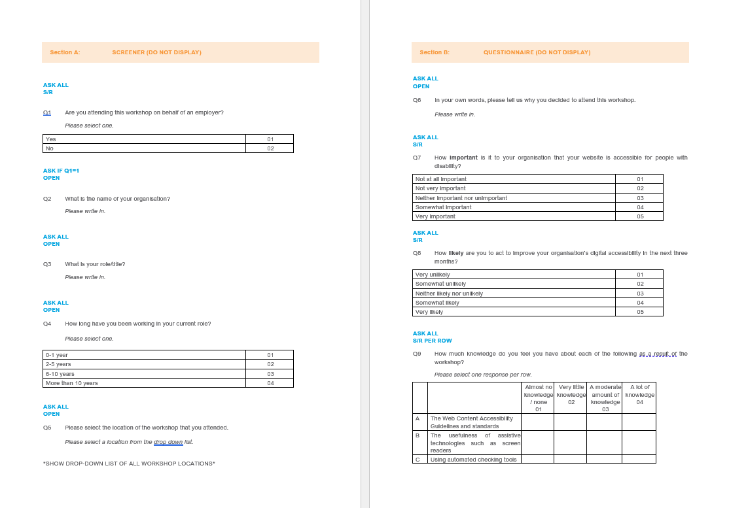

Slide 88
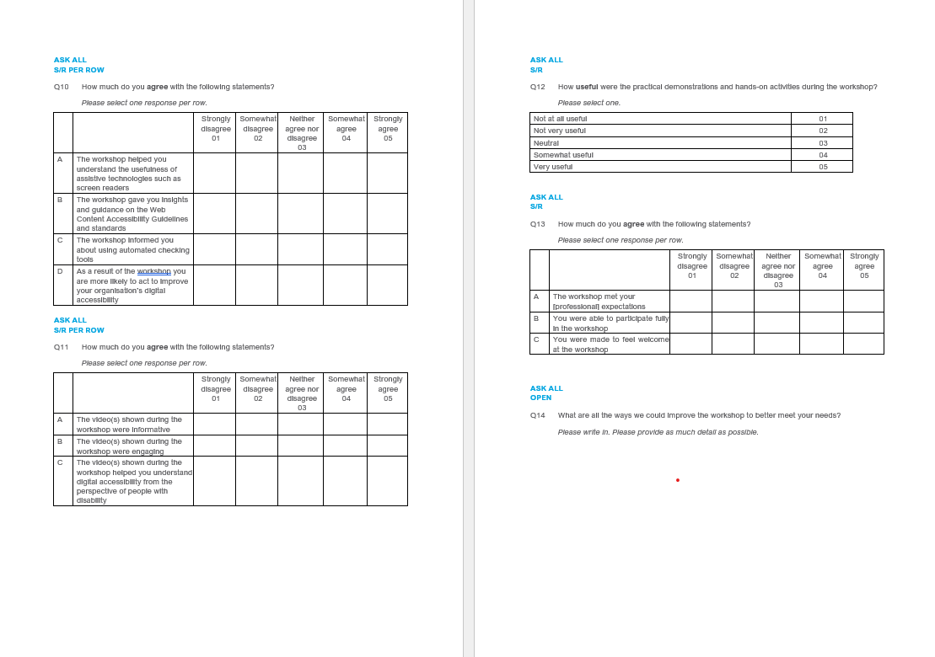

Slide 89


Slide 90
Appendix 5: Pre-course survey

Slide 91
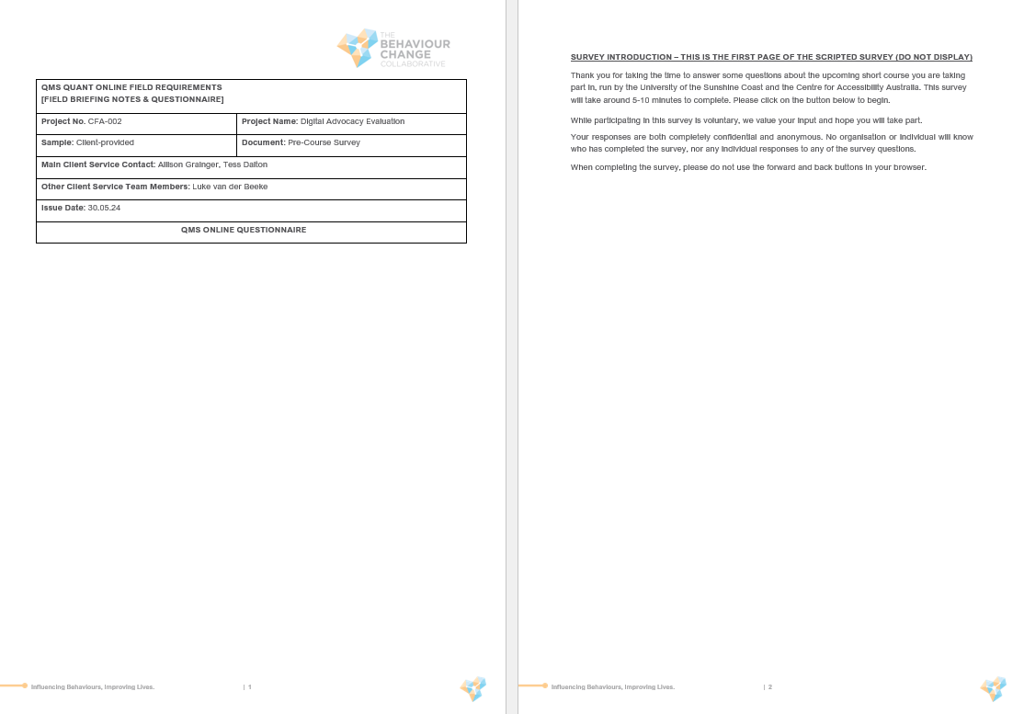

Slide 92
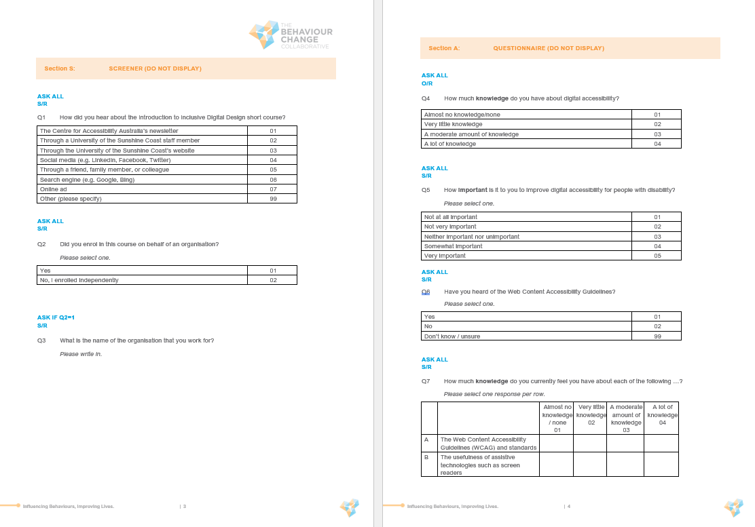

Slide 93
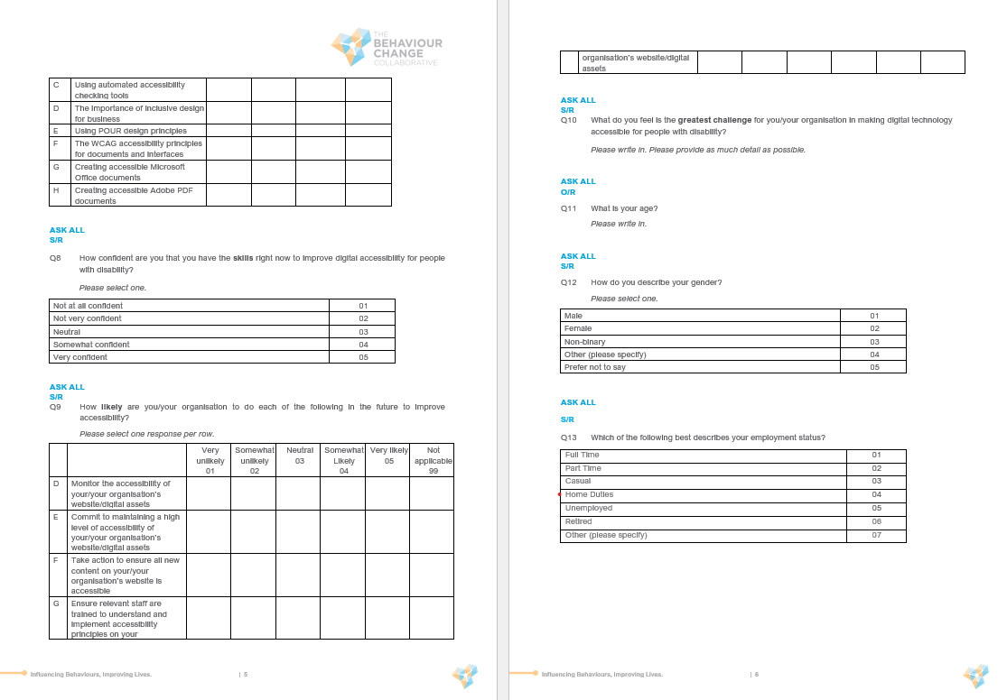

Slide 94
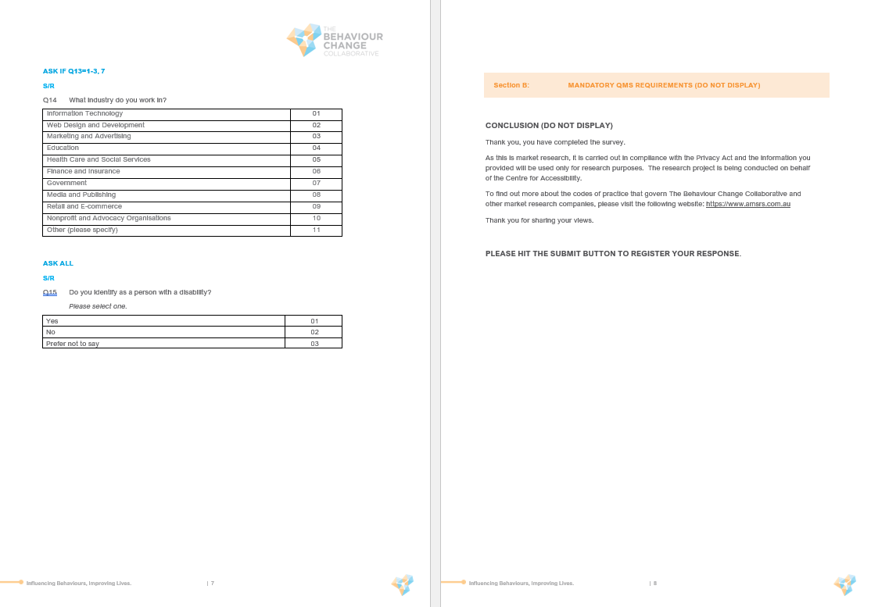

Slide 95
Appendix 6: Post-course Survey

Slide 96
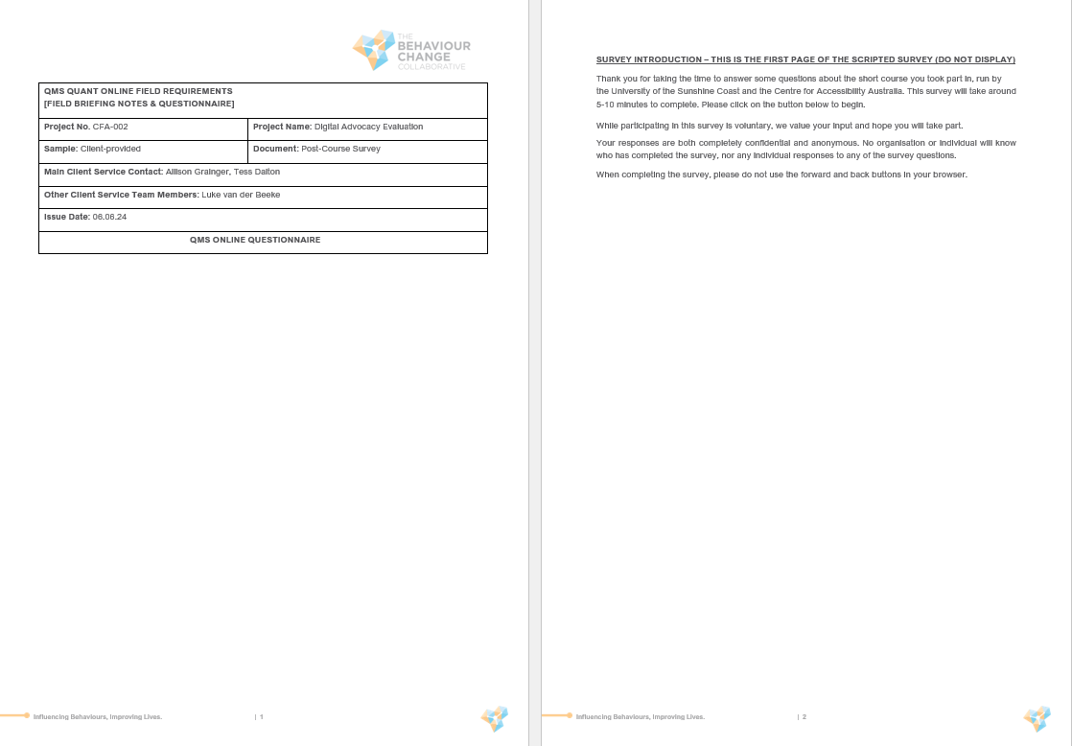

Slide 97
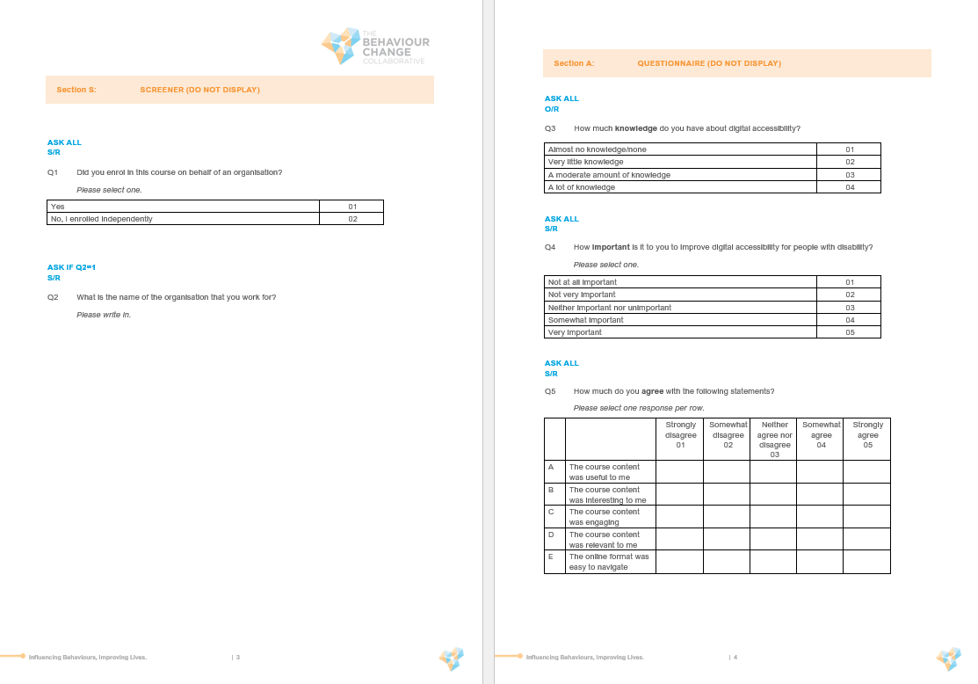

Slide 98
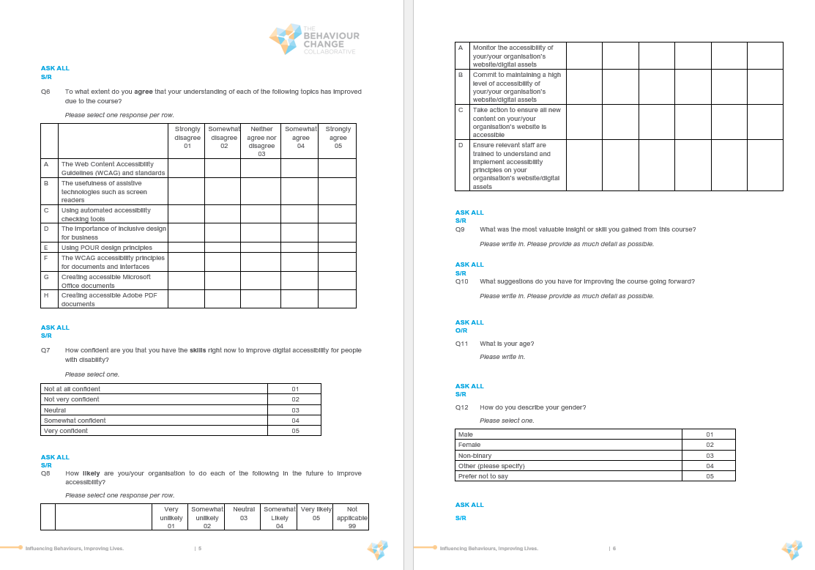

Slide 99
